Slide 1
Meeting Coal Authority
Mylene Receveur
16/01/2020
Ian Watson, Christopher McDermott, Andrew Fraser Harris

Slide 2
Shafts

Slide 3
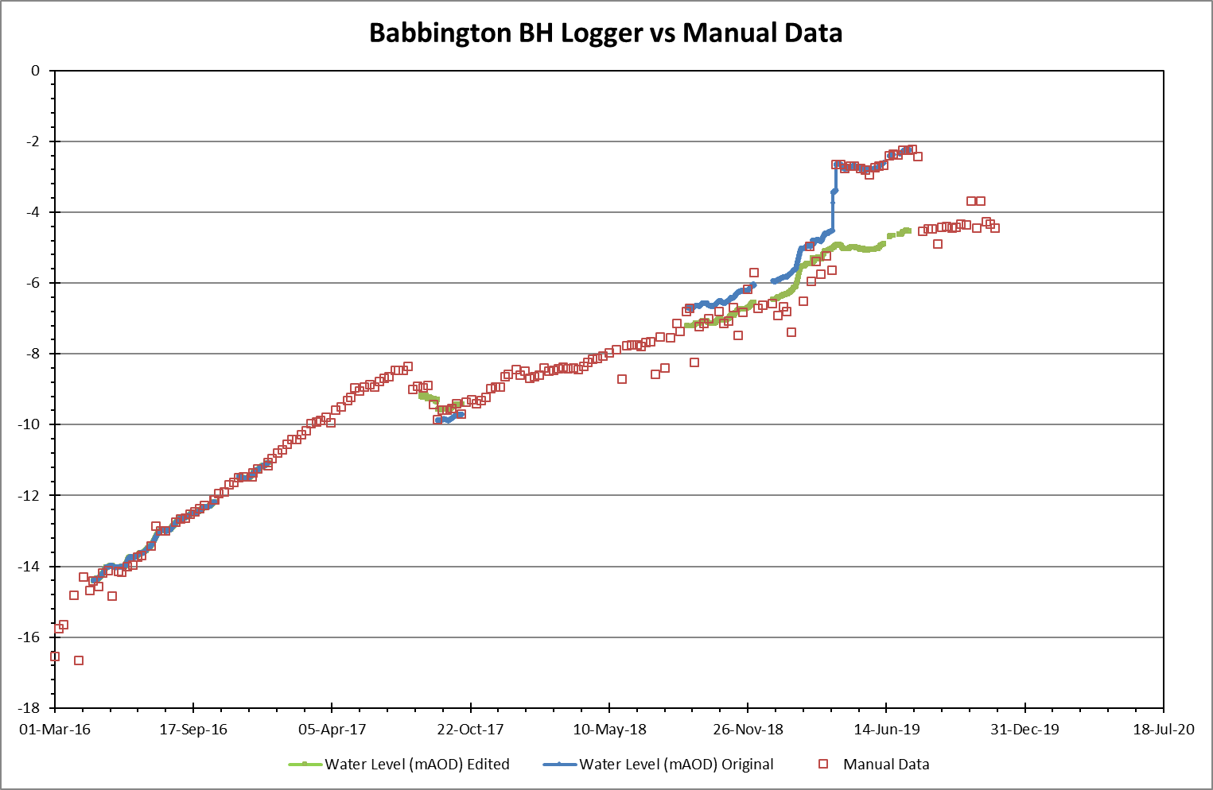
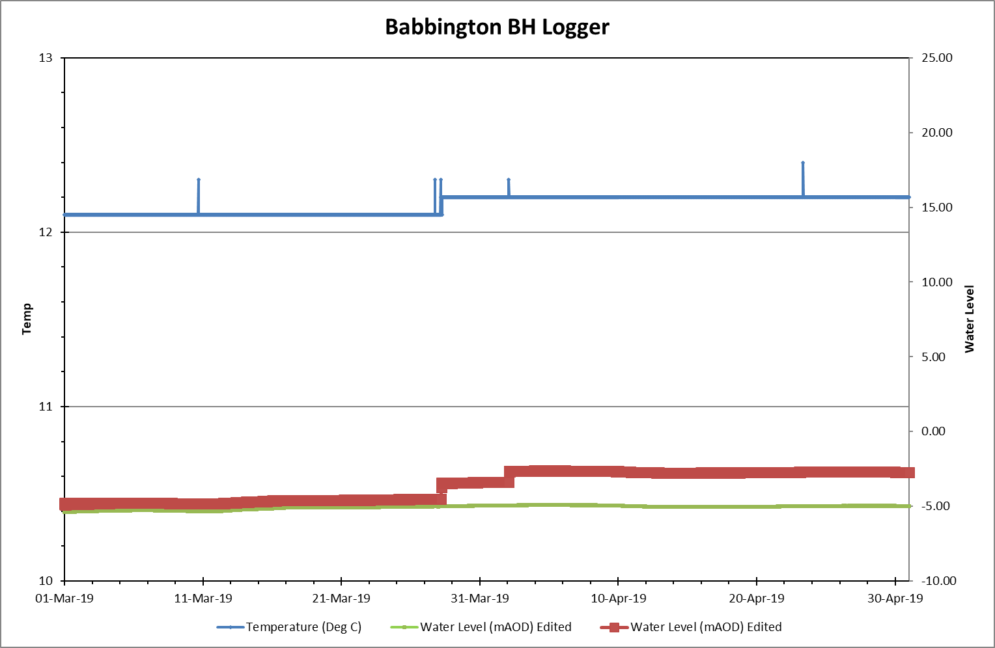
Babbington

Slide 4
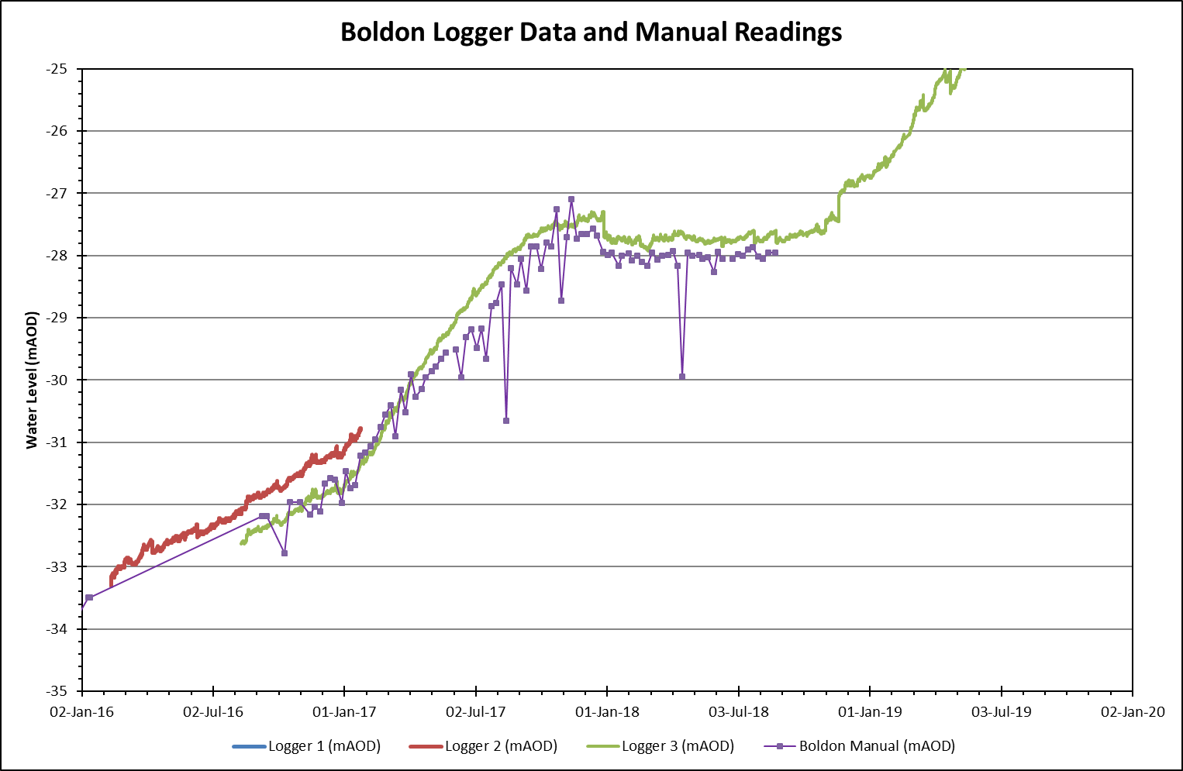
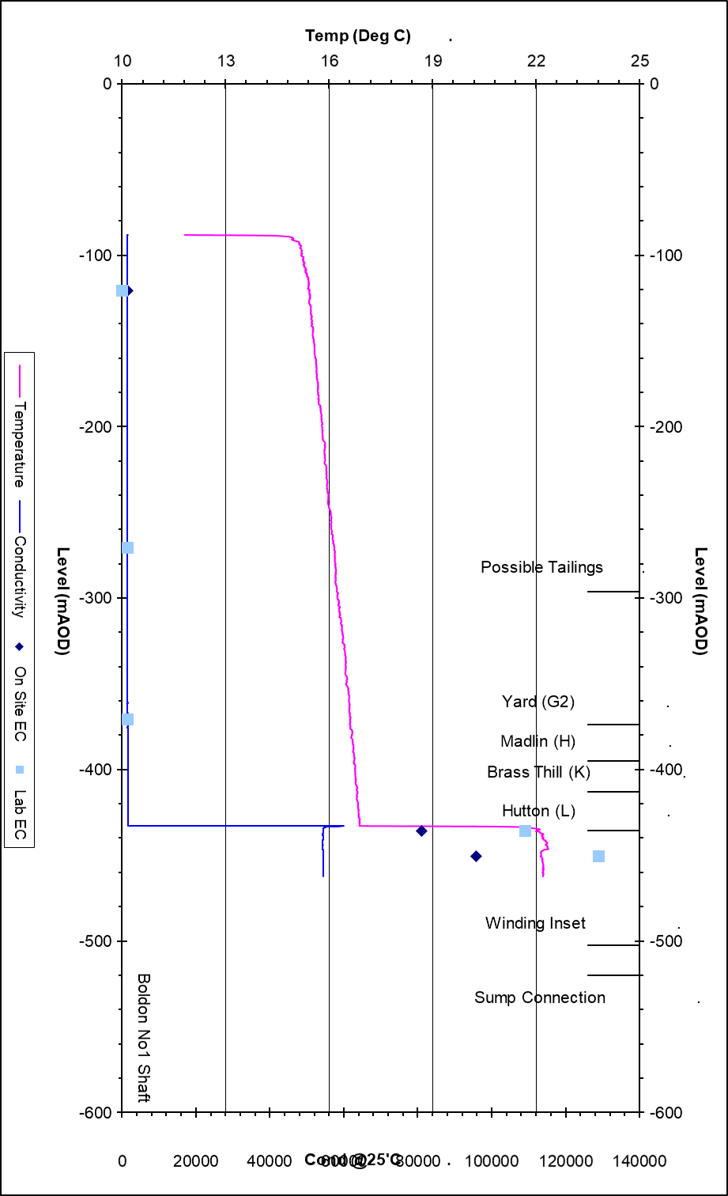
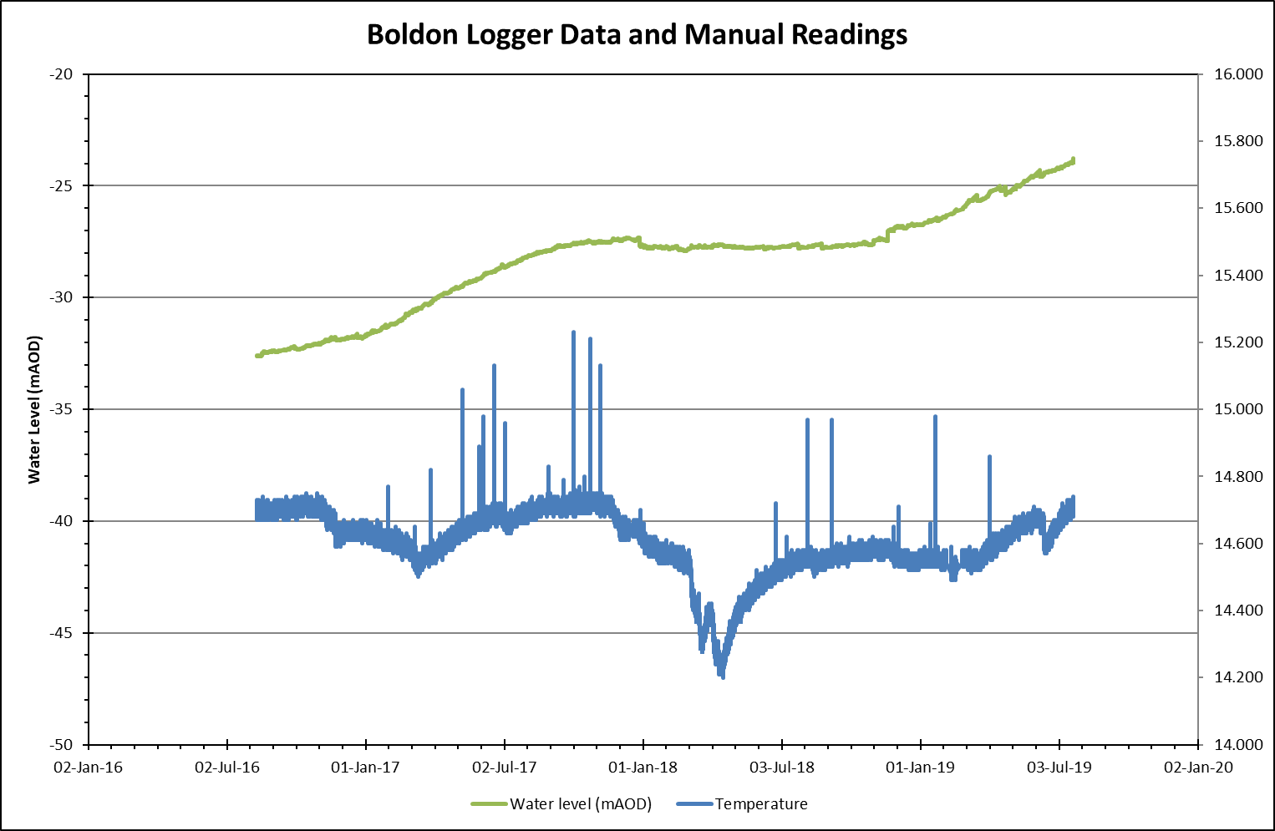
Boldon

Slide 5
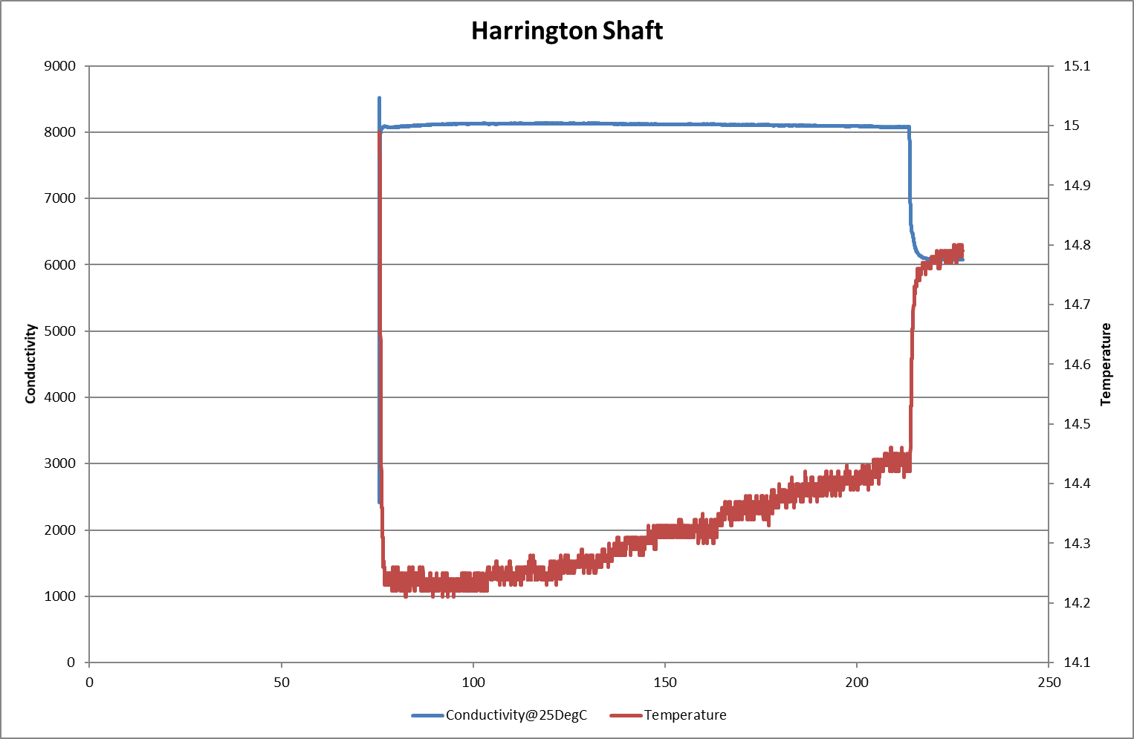
Hartington shaft – ECT LOG

Slide 6
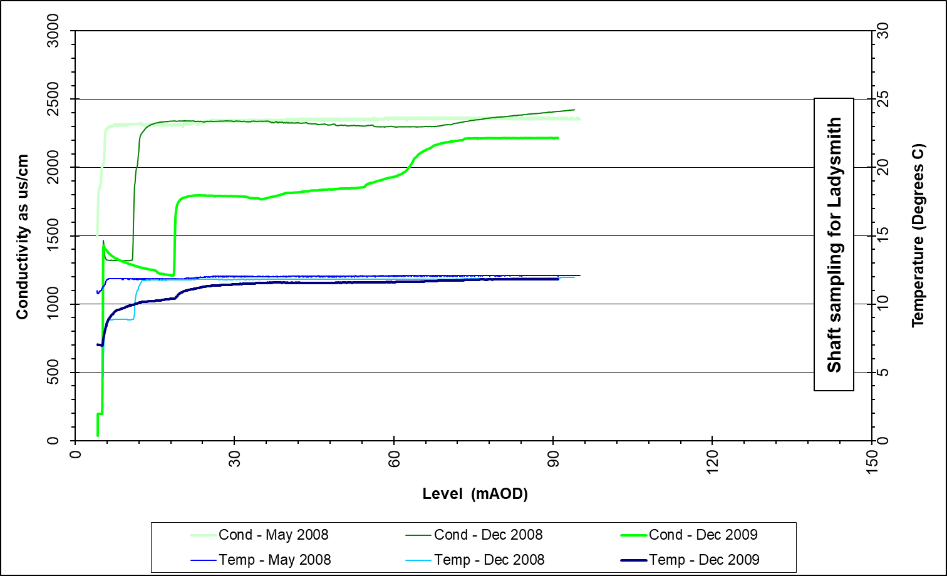
Ladysmith

Slide 7
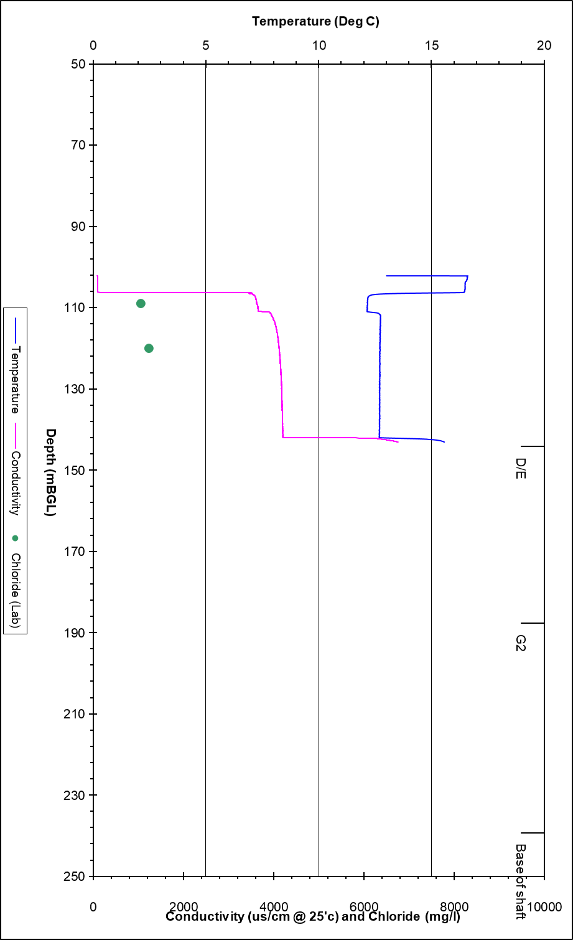
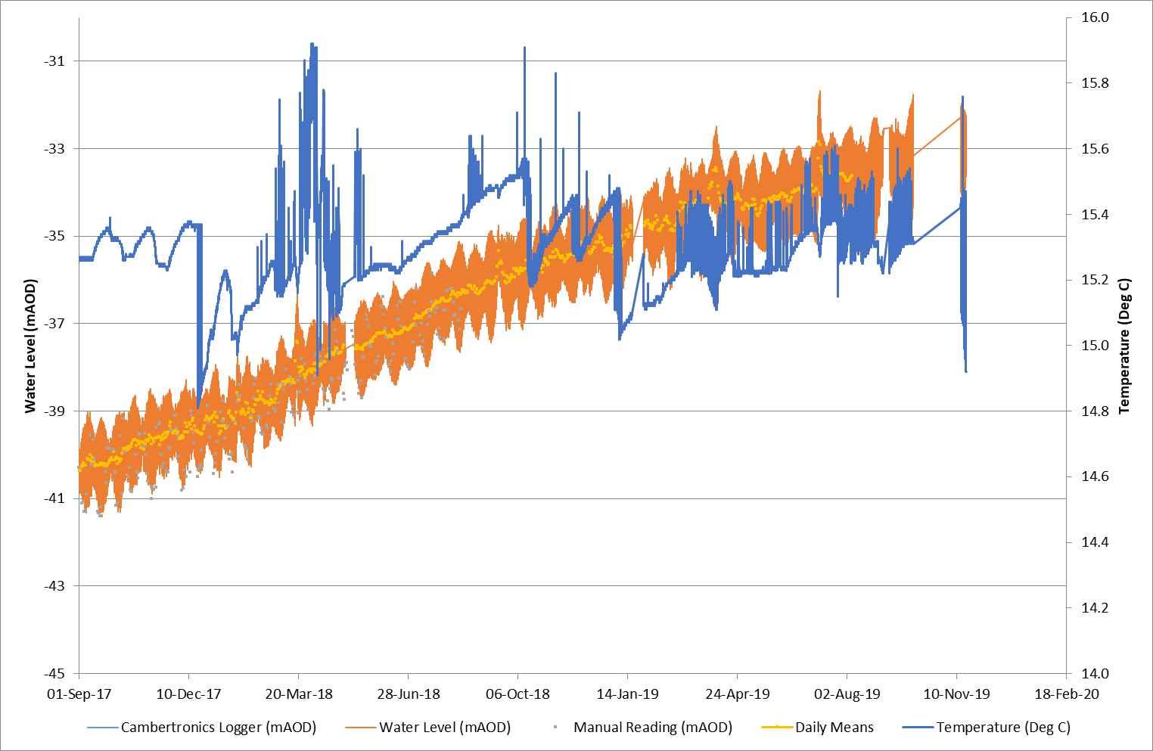
Lynemouth

Slide 8
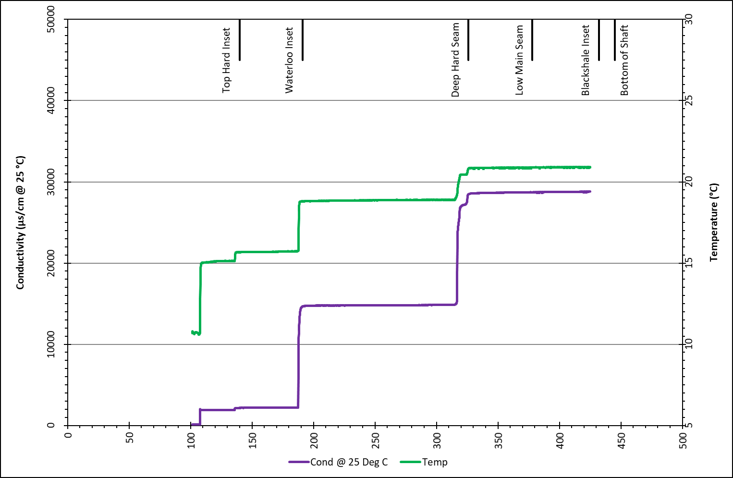
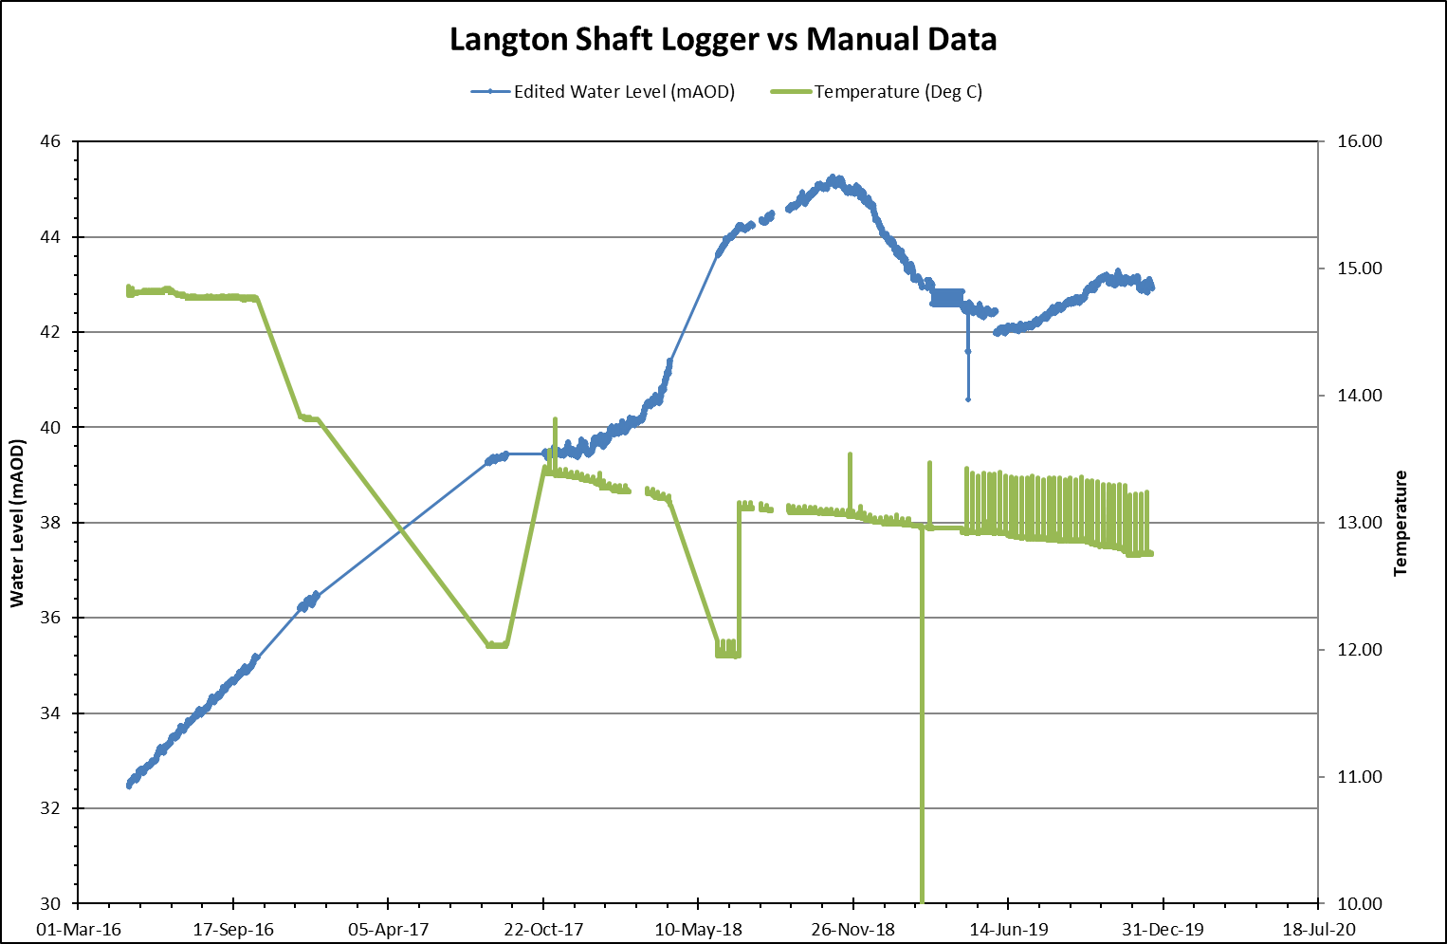
Langton No7 shaft ECT Log 2013 Water Level LOG

Slide 9
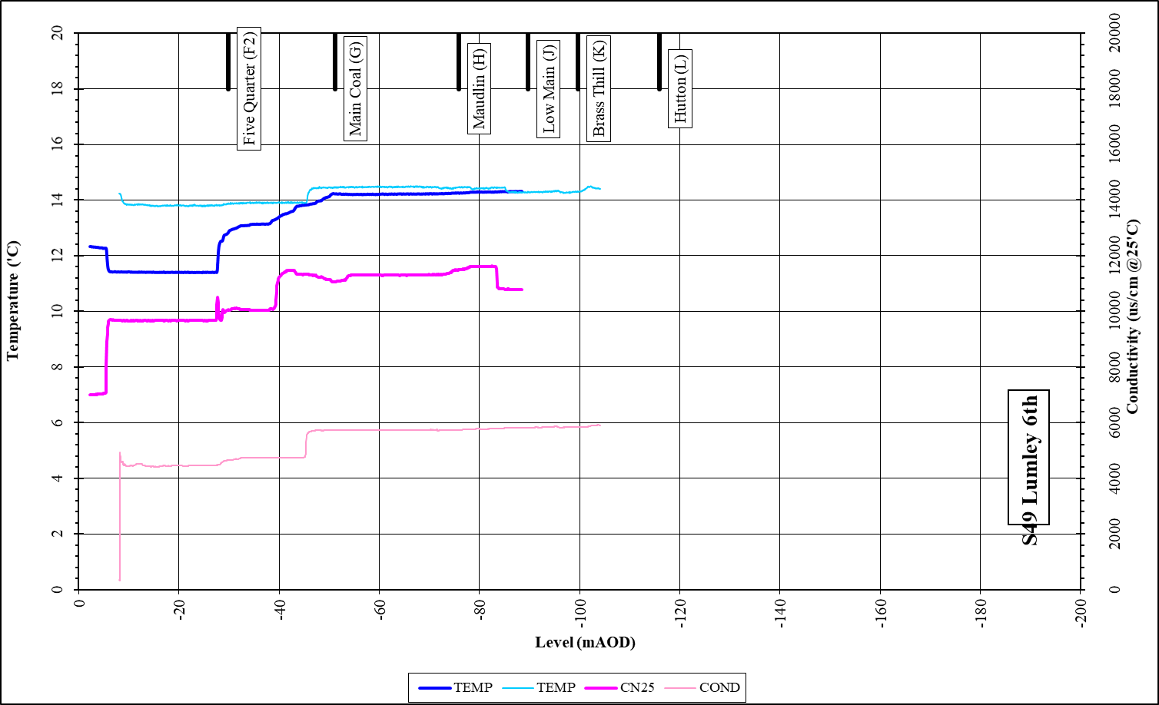
Lumley 6th shaft

Slide 10
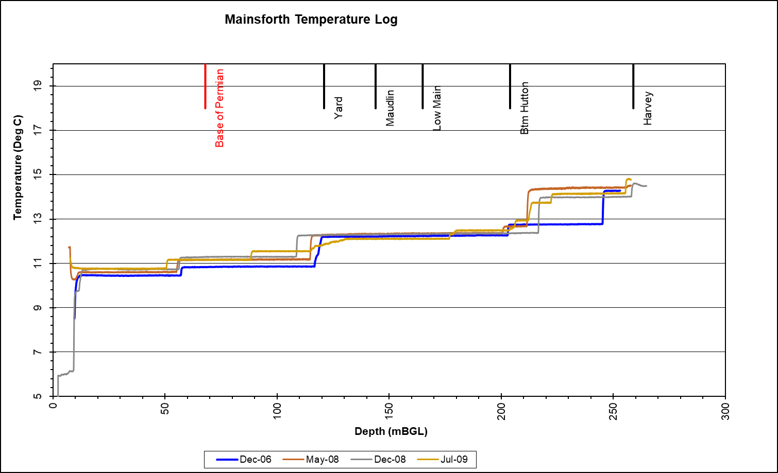
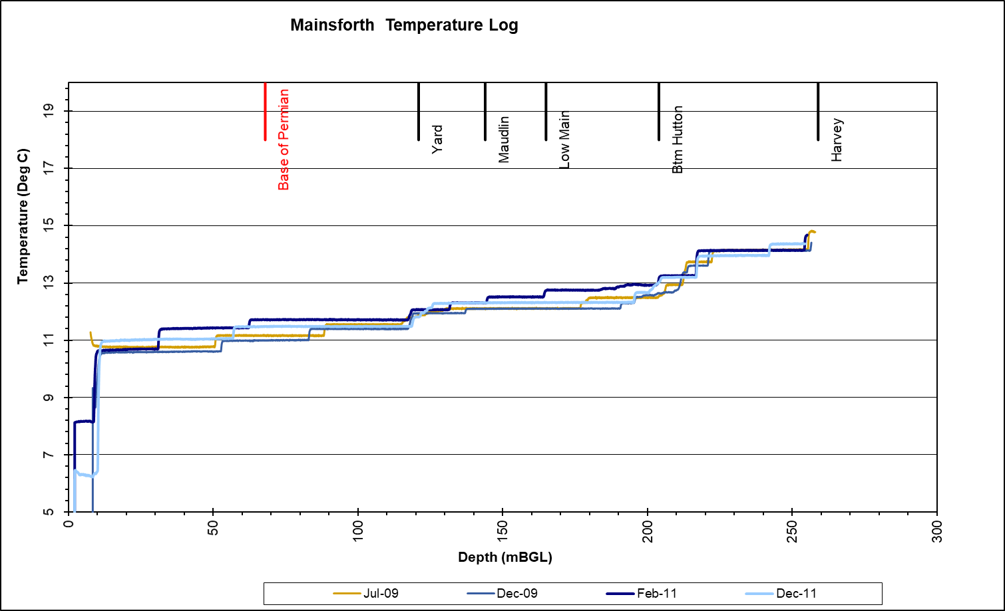
Mainsforth
mine flooded for > 25 years (recovered in late 70's)
EC-T logs for study of seasonal variability in chemistry

Slide 11
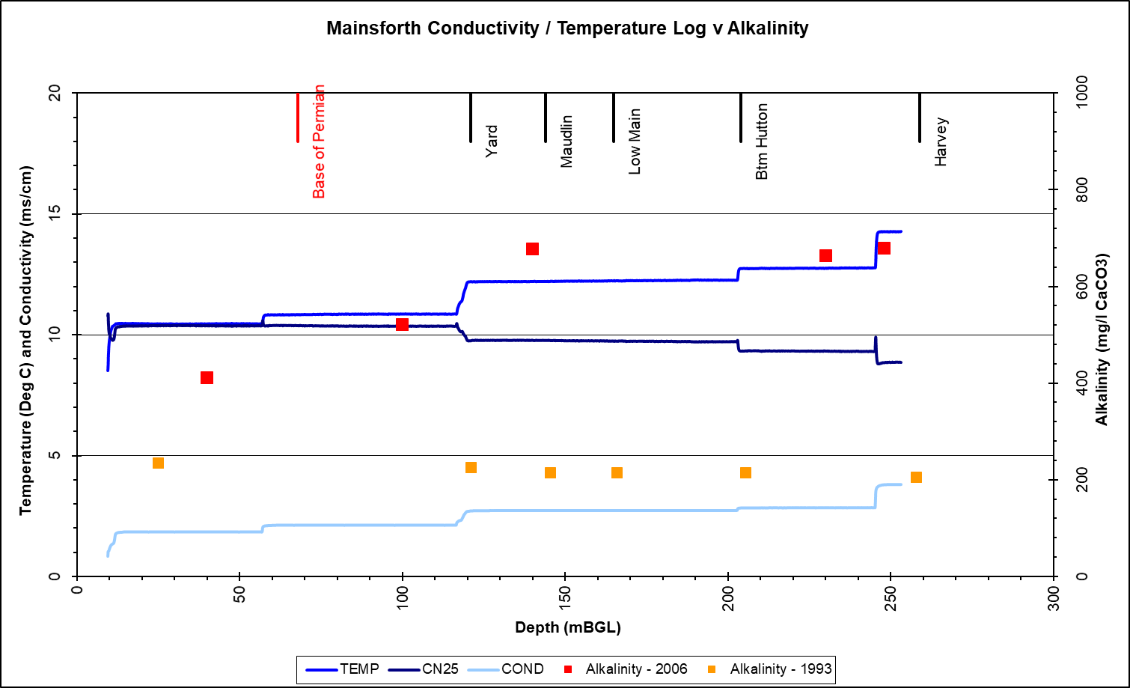
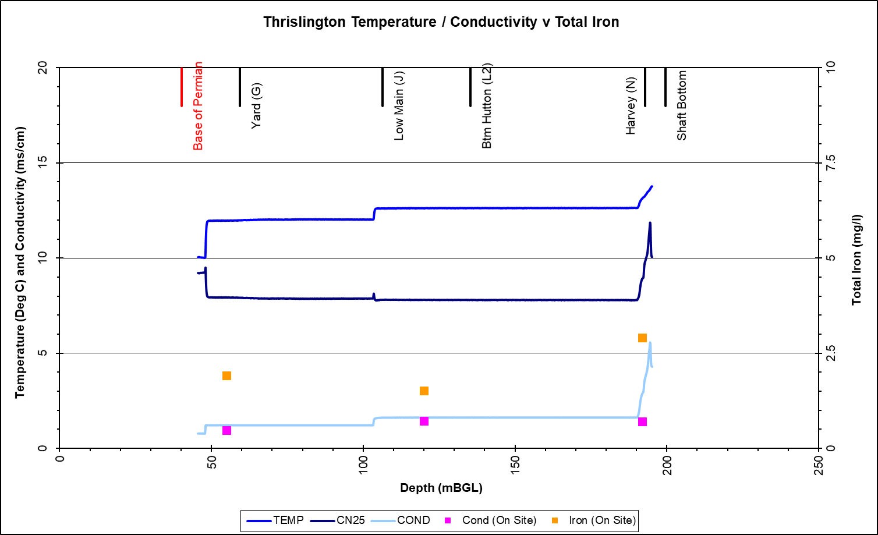
Mainsforth / Thrislington

Slide 12
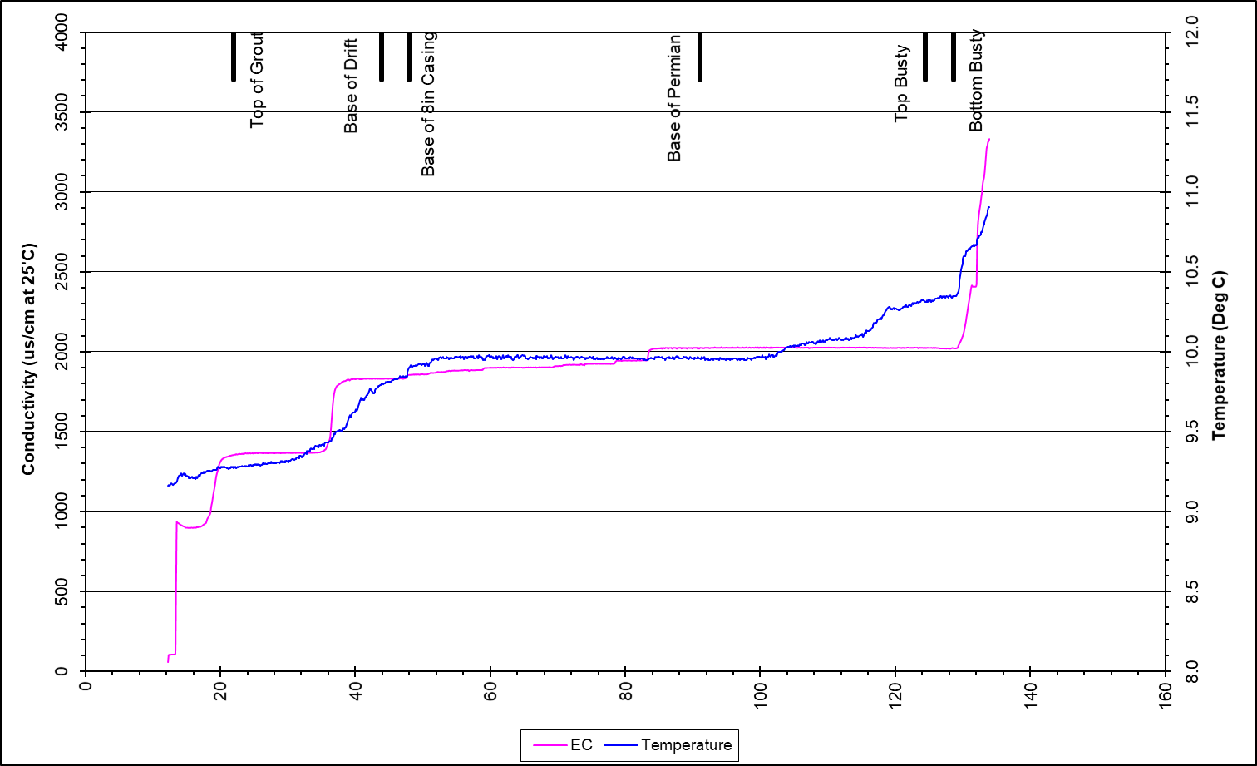
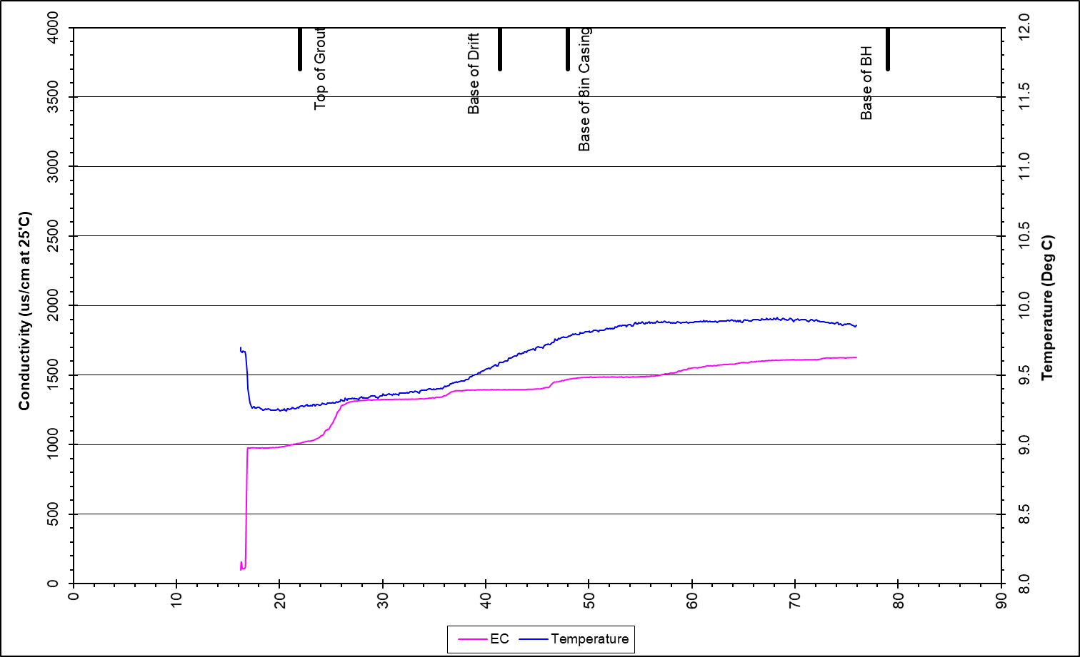
Stony Hall CM / Mag Lst

Slide 13
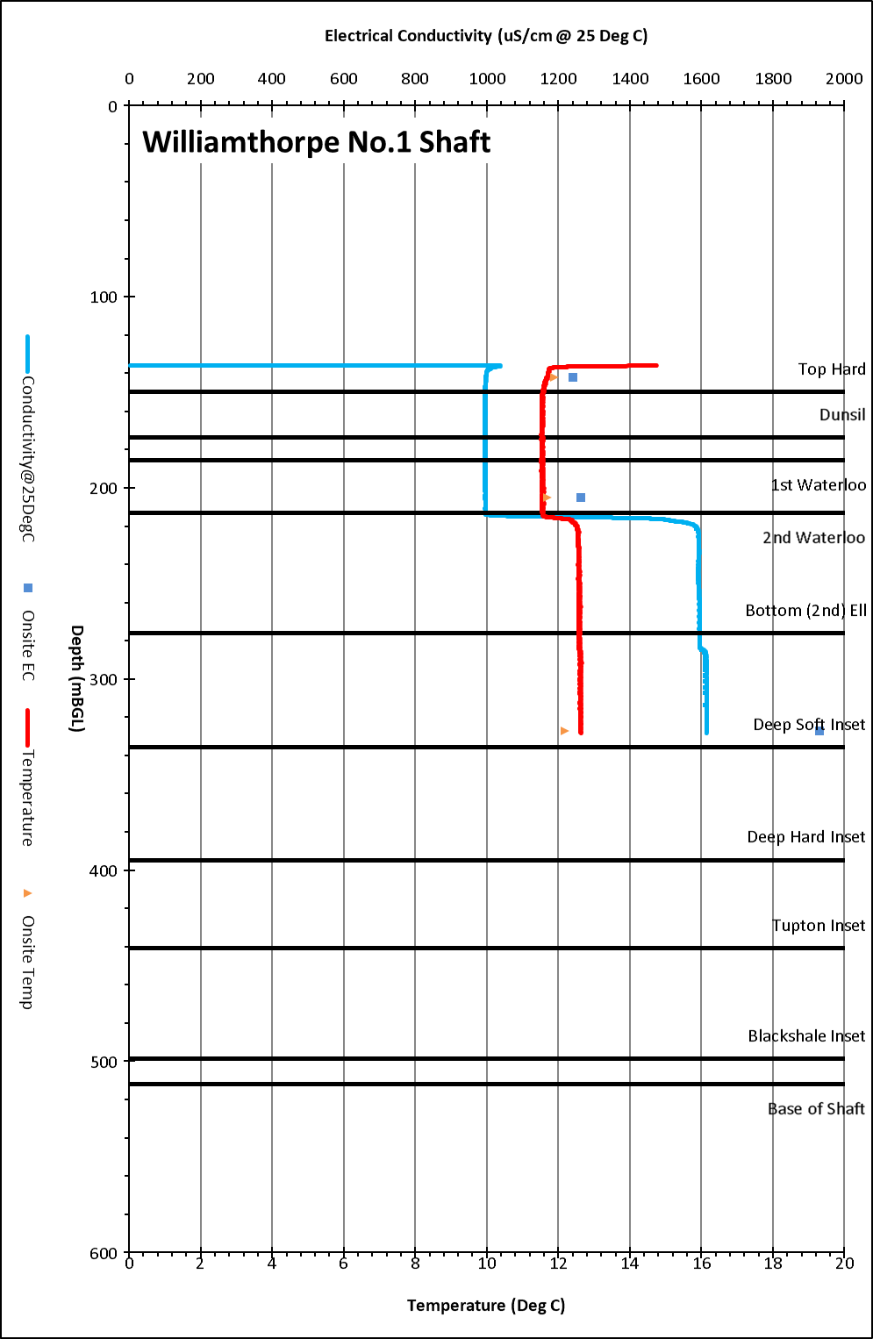
Williamthorpe Shaft ECT Log 2017

Slide 14
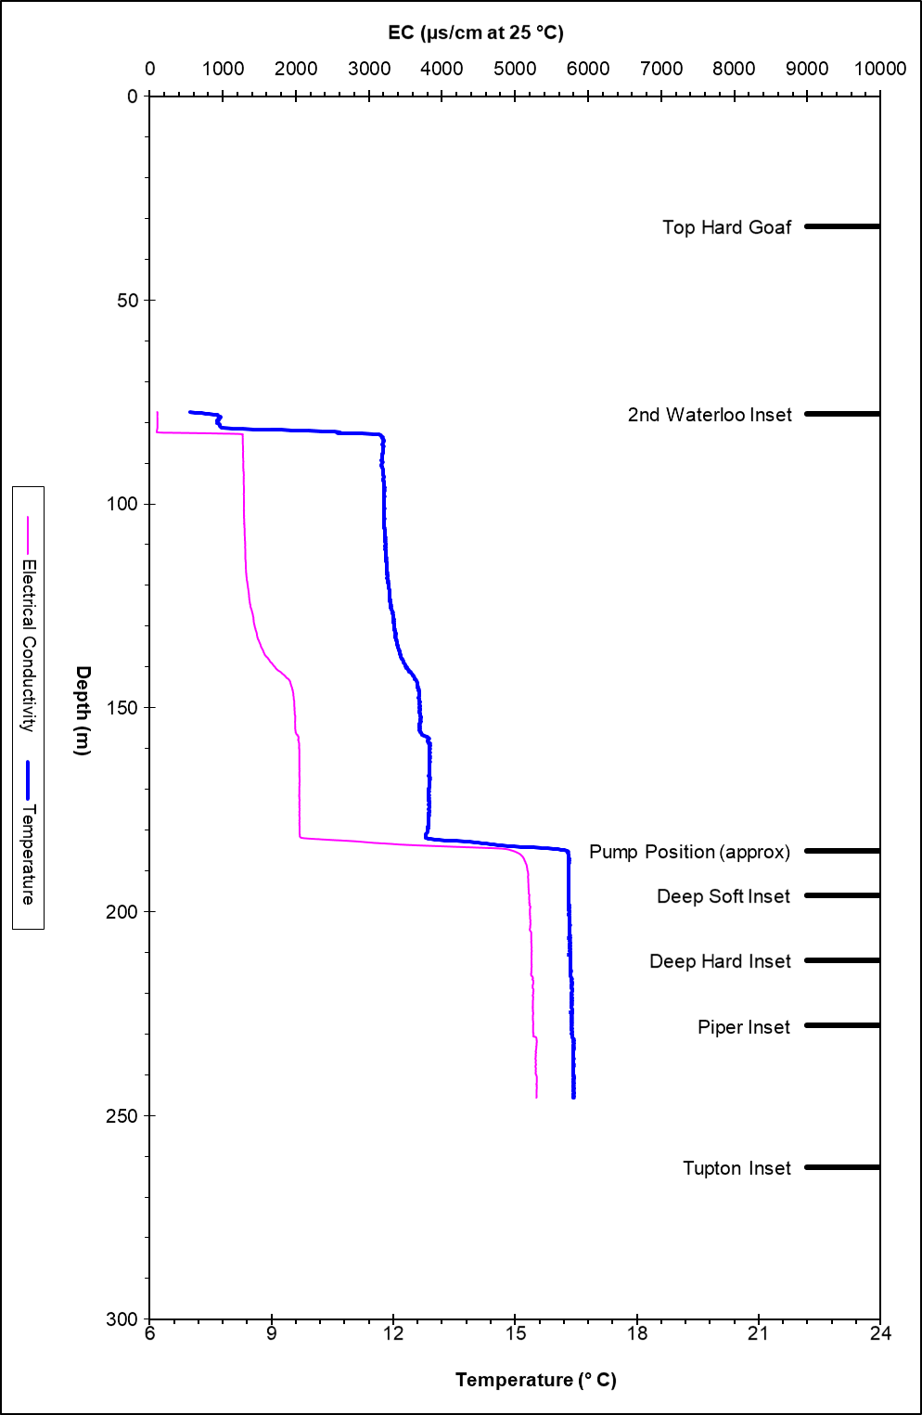
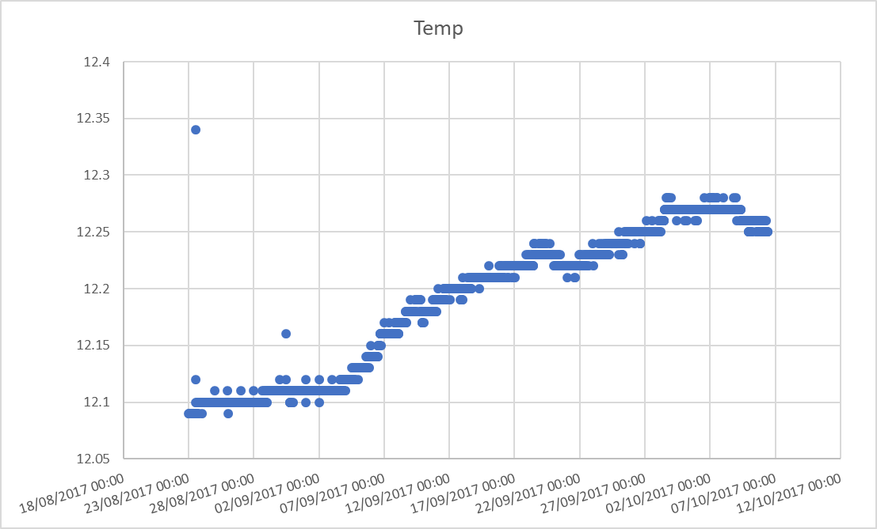
Woodside Logger Data ECT Log 2010

Slide 15
Borehole
Missing Logger data:
Balgone Dalginch
Balgone Muirespot
Missing water level Logger
Balgonie Dalginch BH (monitoring borehole)
Mosside BH (Monitoring BH)
Rigside (Monitoring BH)
Pumping test
Cadley Hill BH
ECT Log
Leacroft (Monitoring BH) – 2019
Littleton (Monitoring BH) – 2019
Stony Heap – 2009
West Cannock No5 Aquifer and Seam BH - 2019
On-site testing
Tollcross Burn (Monitoring BH)

Slide 16
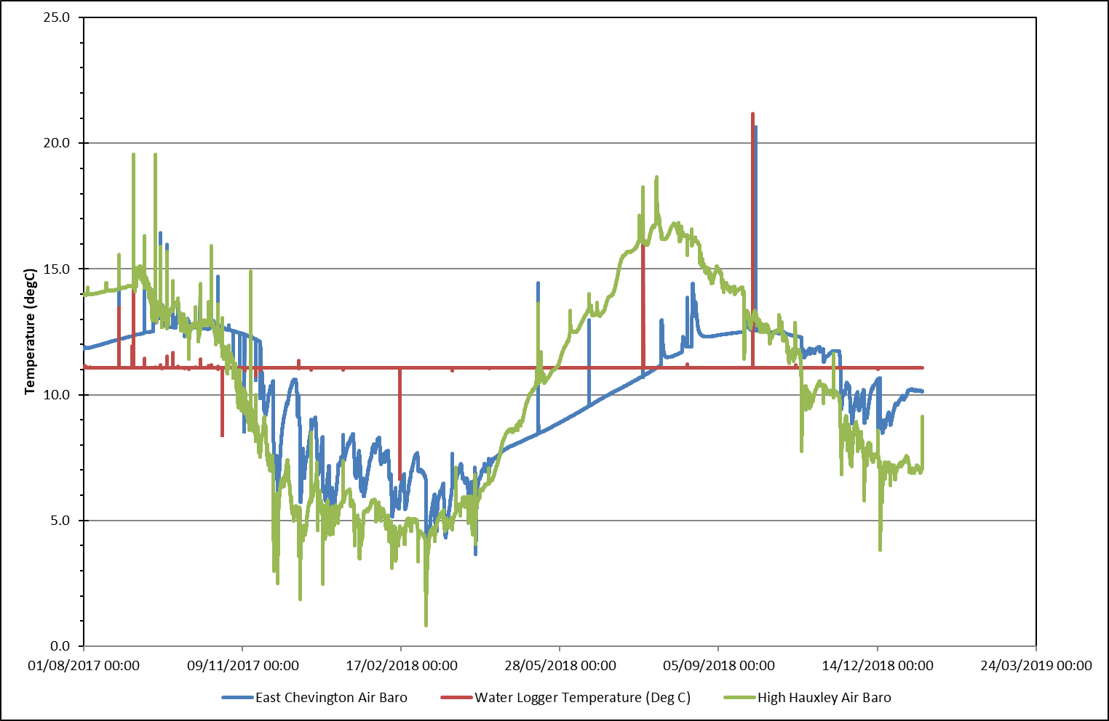
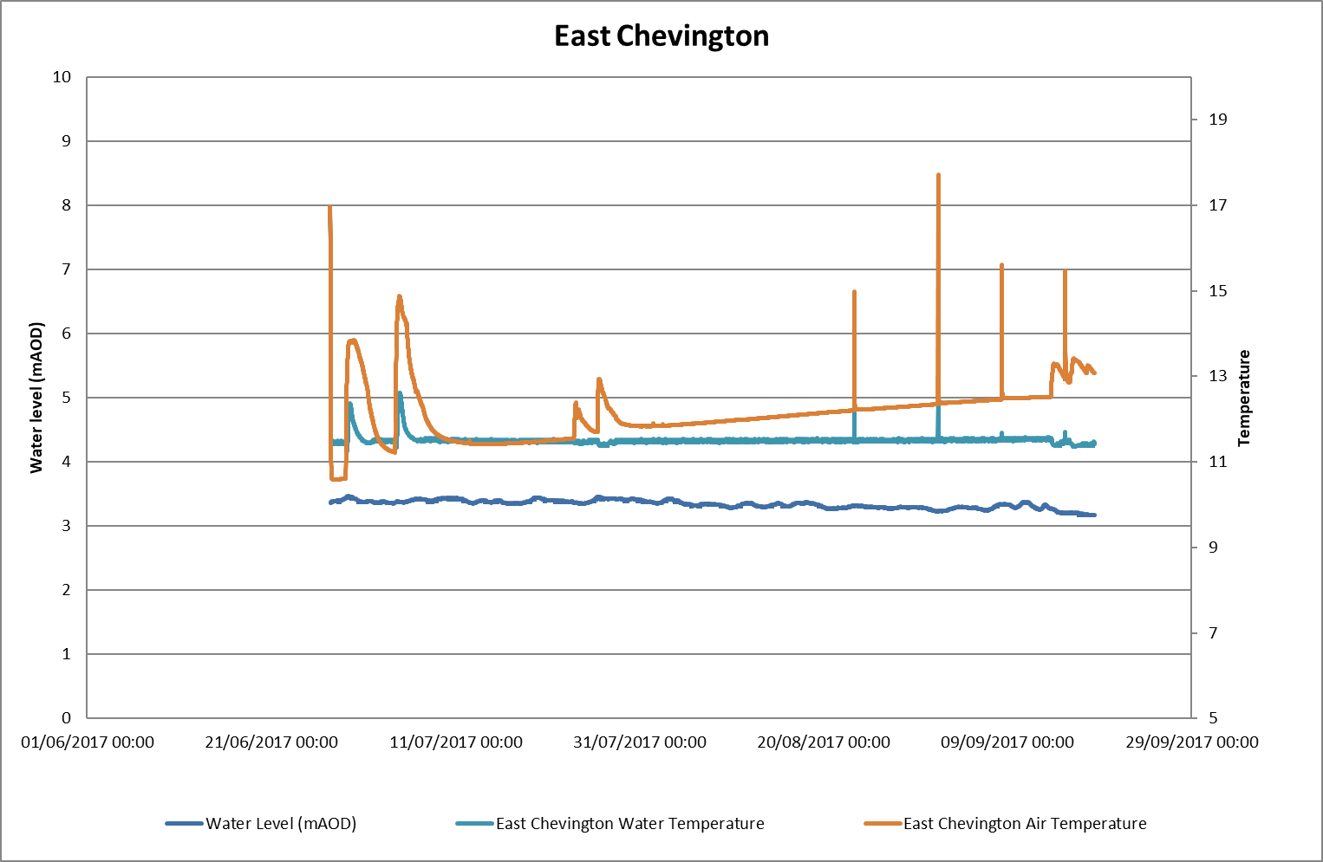
Broomhill – Water Level Log + East Chevington / High Hauxley Baro

Slide 17
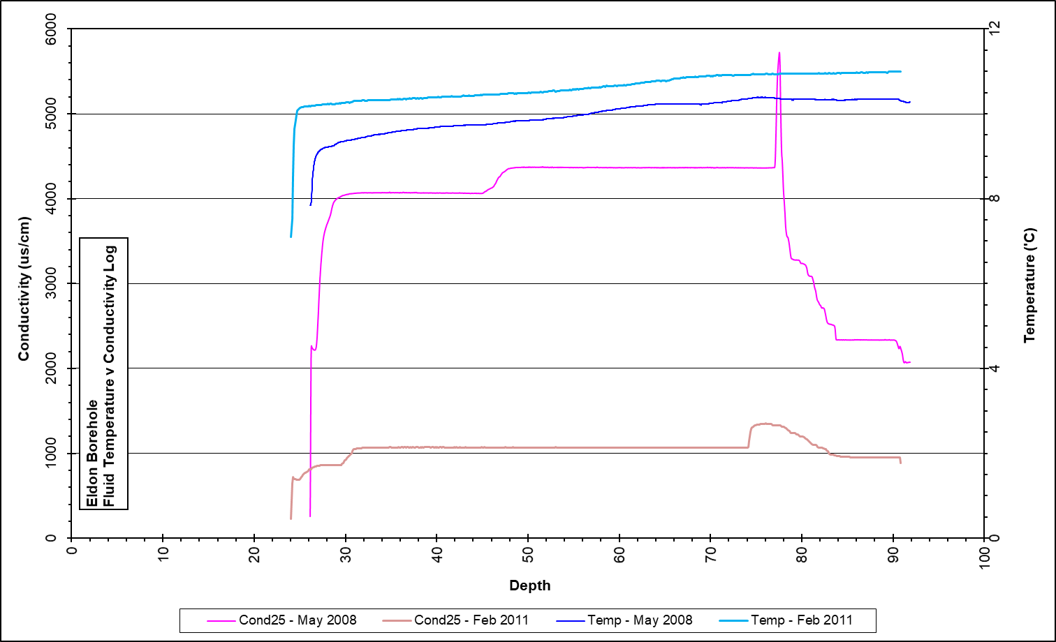
Eldon

Slide 18
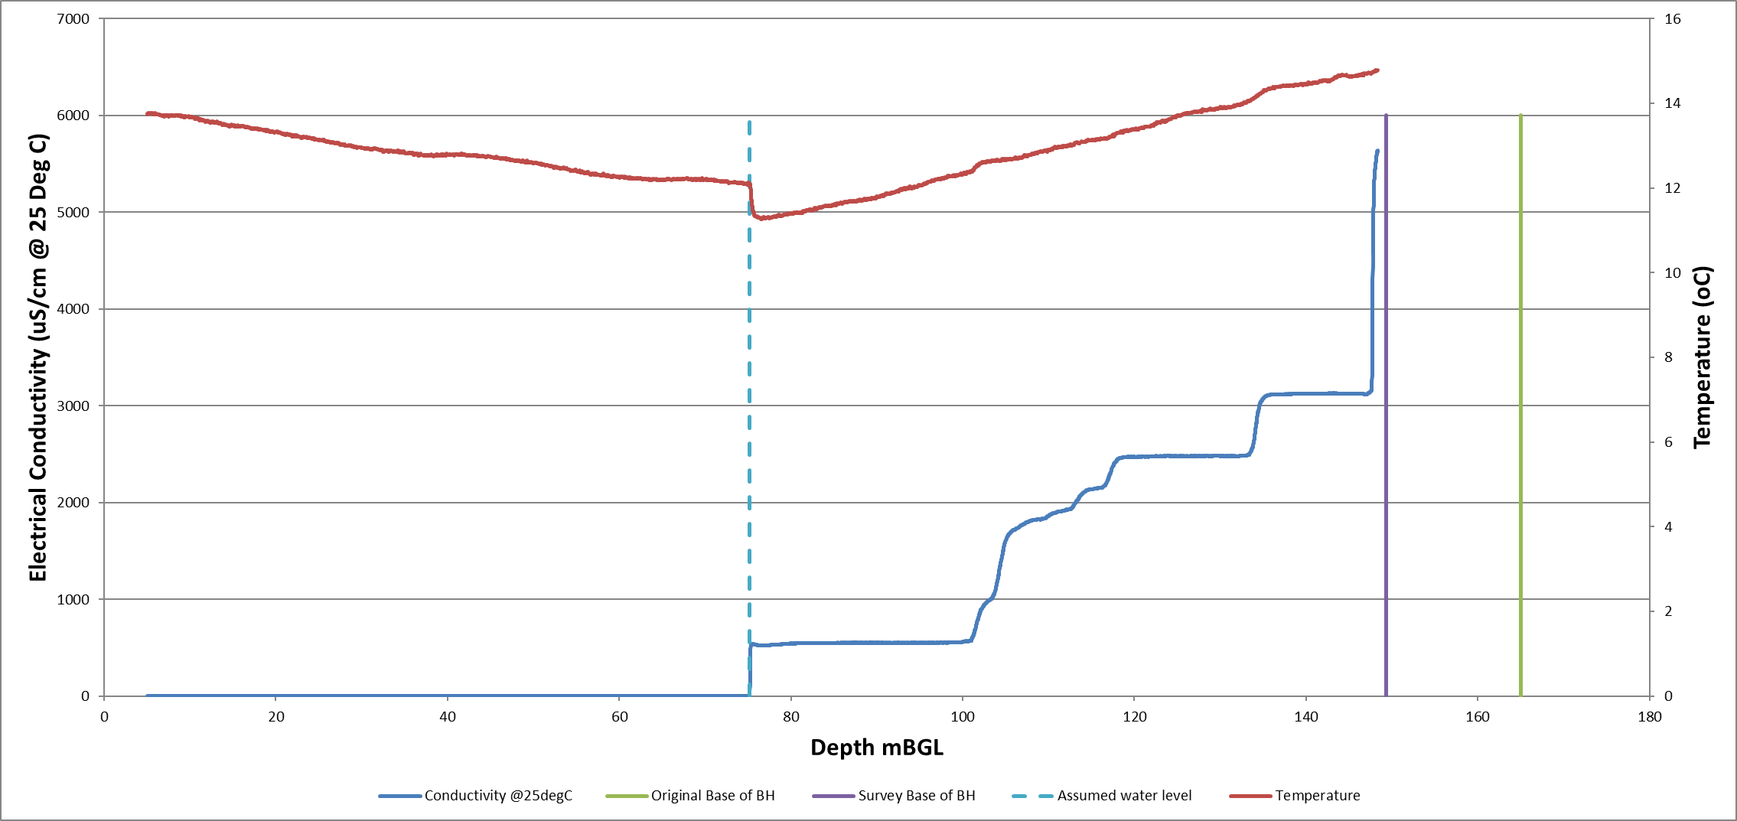
Leacroft (Monitoring BH) – 2019

Slide 19
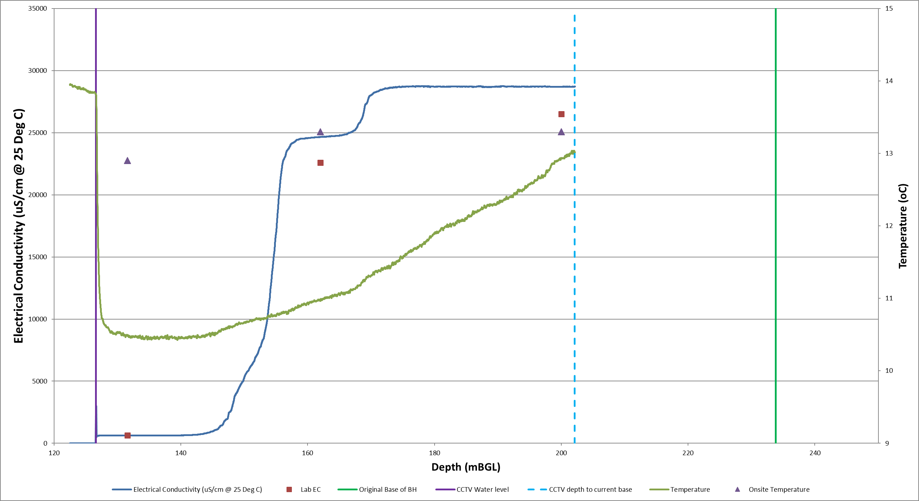
Littleton (Monitoring BH) – 2019

Slide 20
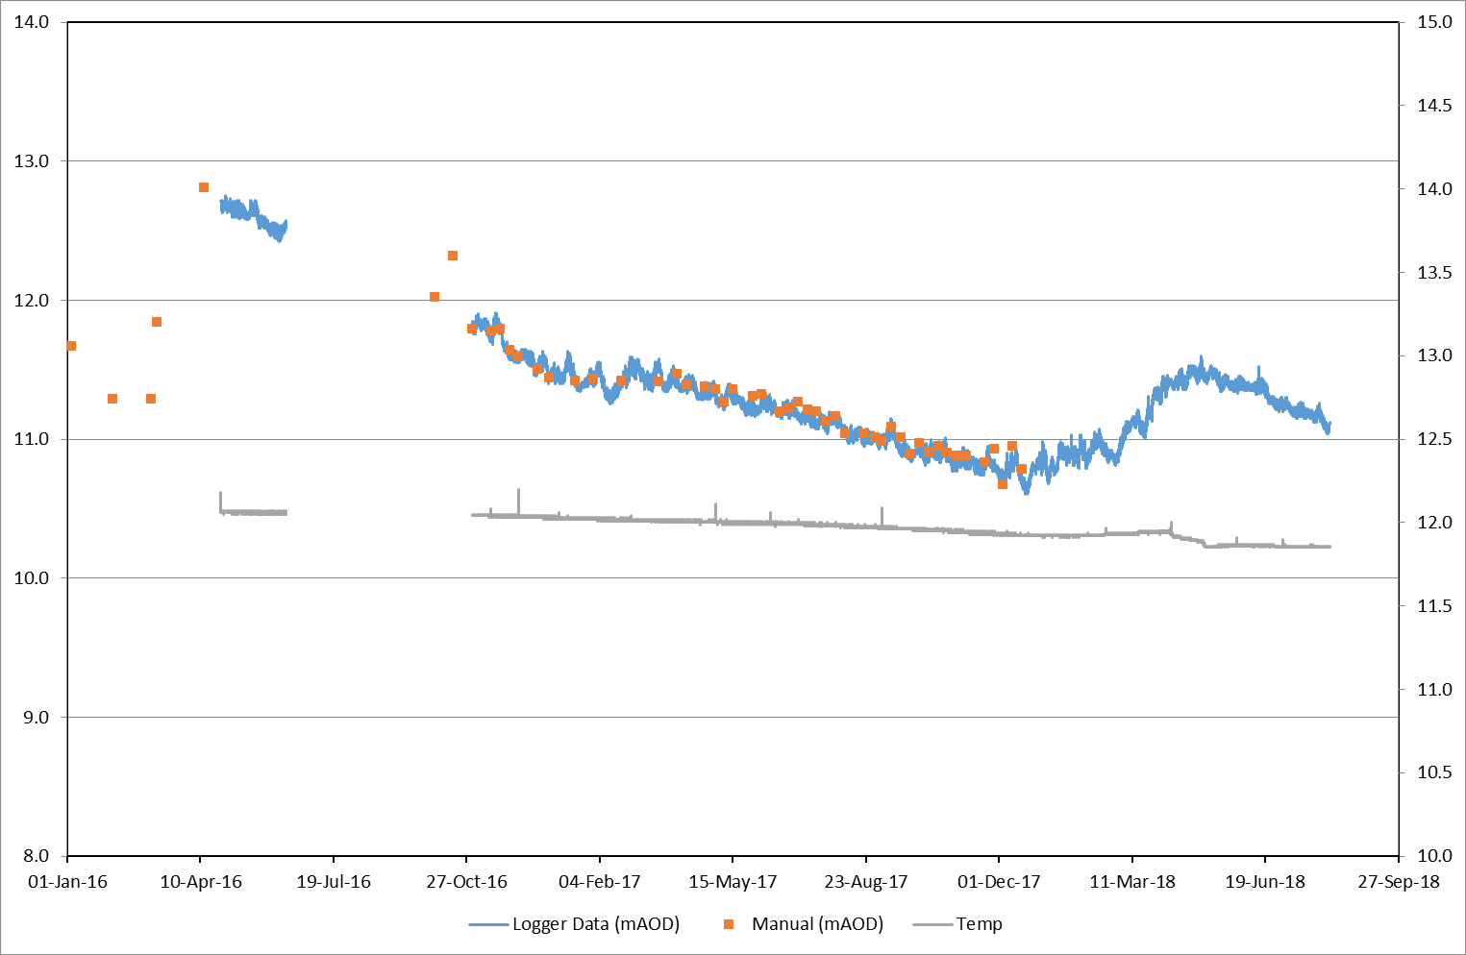
Leven 4 (Monitoring BH) – Water Level Logger

Slide 21
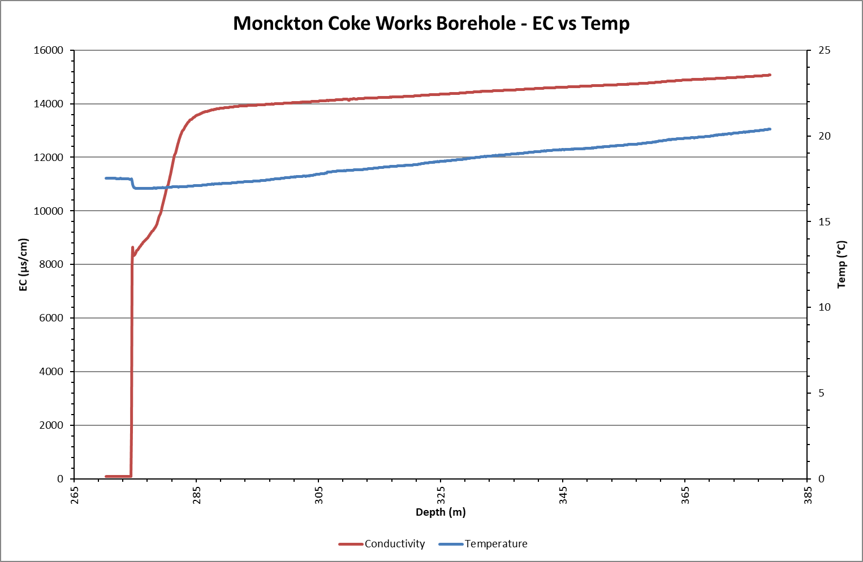
Monckton Coke Works BH ECT Log 2012

Slide 22
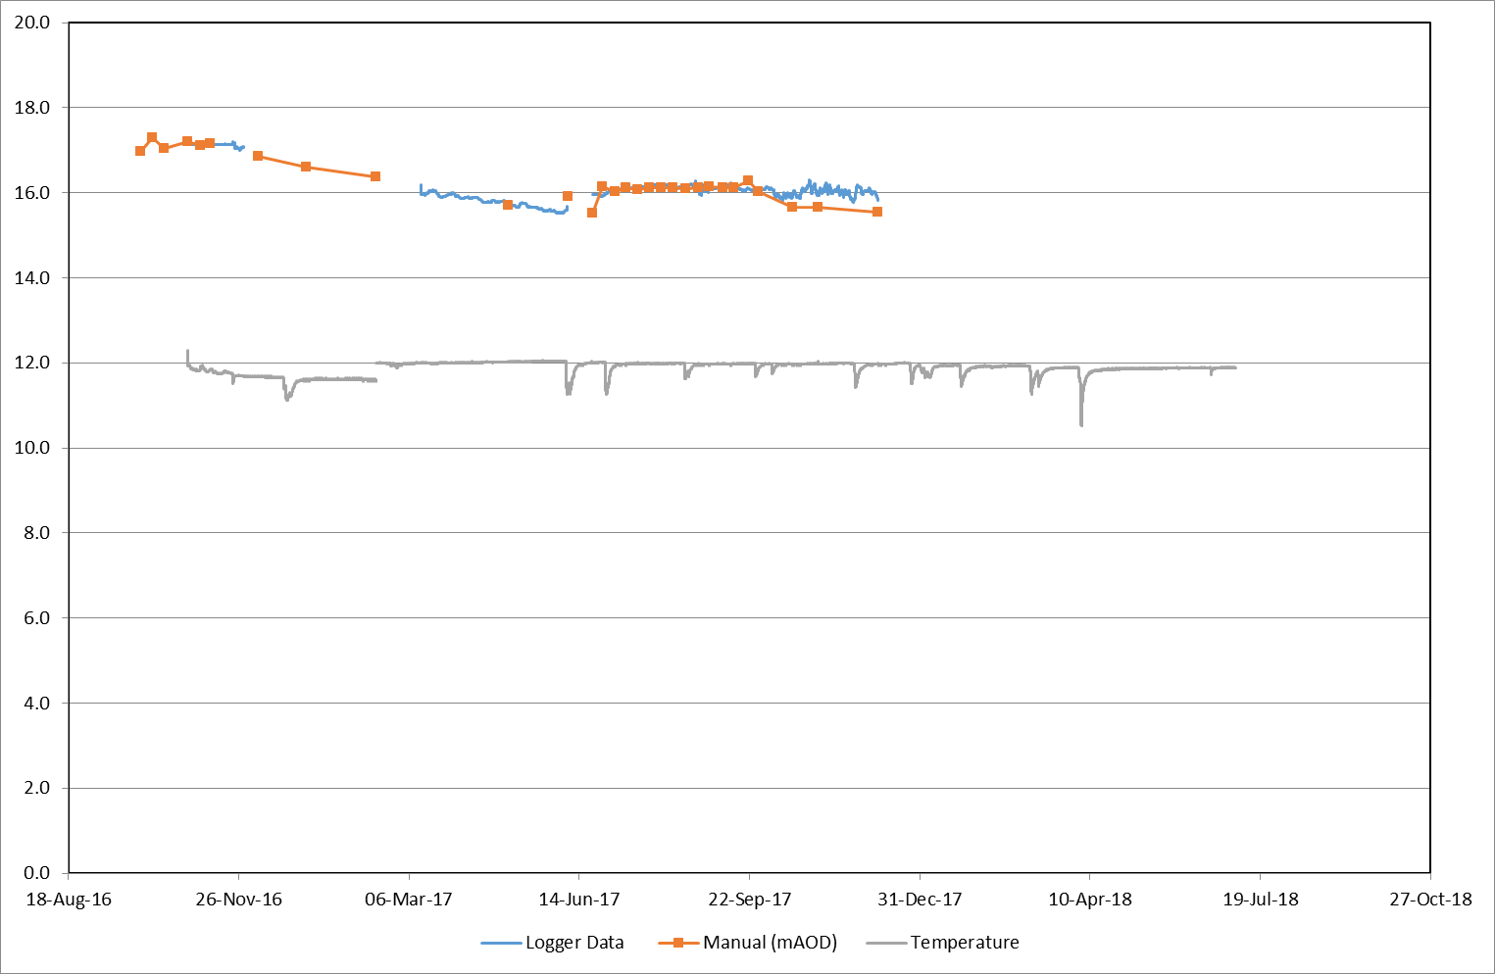
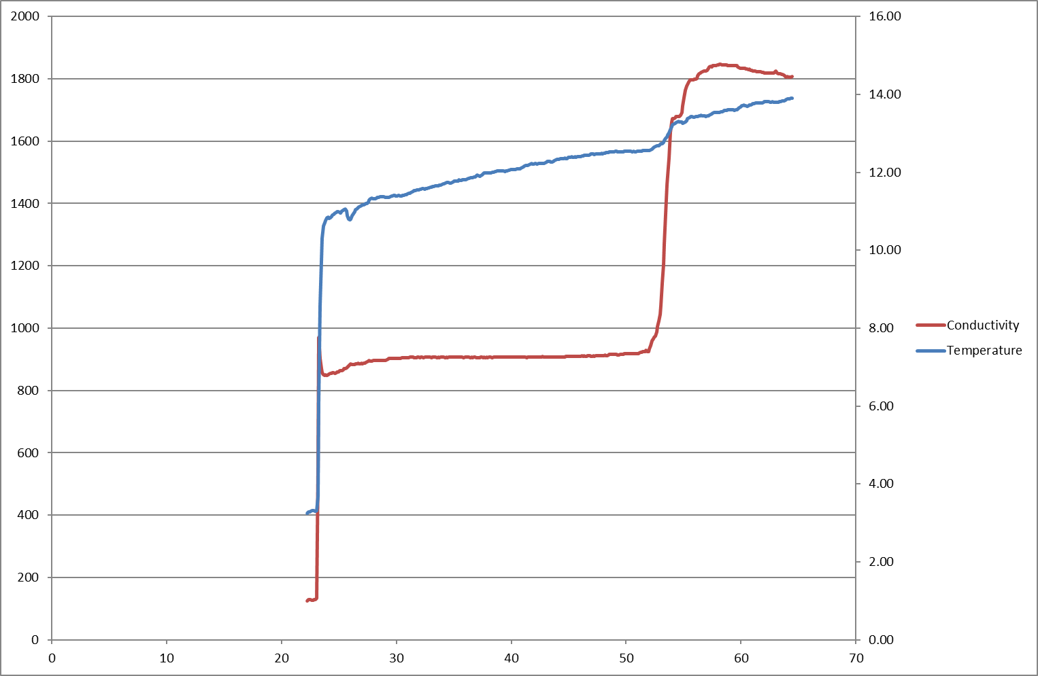
Niddrie (Wisp) BH – Water Level Logger

Slide 23
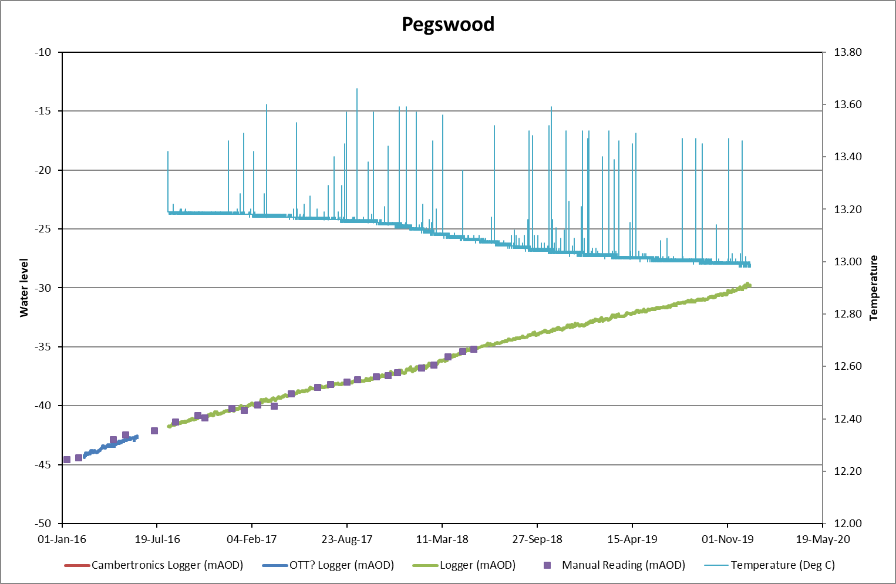
Pegswood Busty (Monitoring BH) Water Level Logger

Slide 24
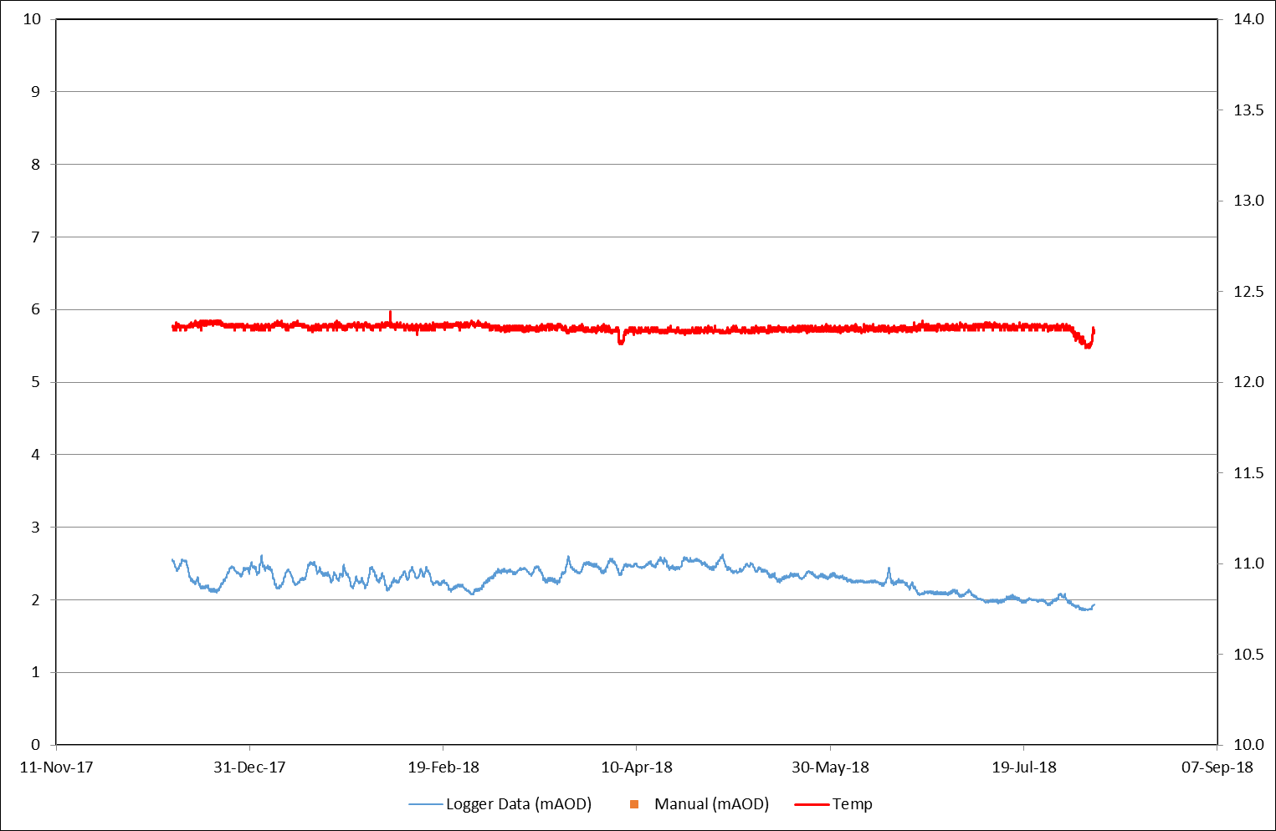
Randolph – Water level Logger

Slide 25
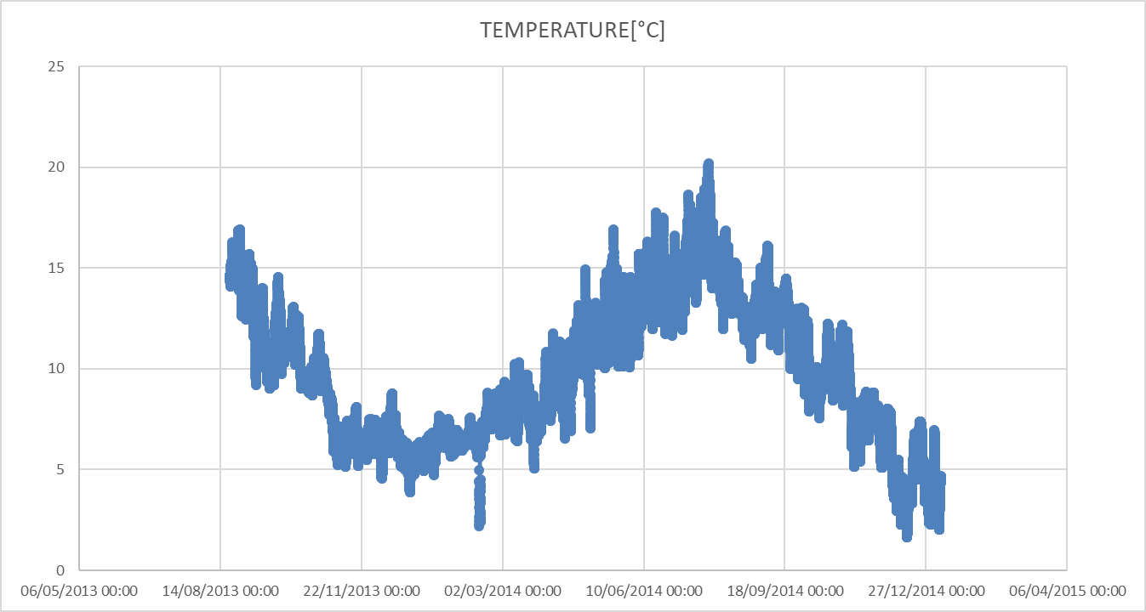
Stoney Hall – Stoney Heap
Stoney Hall Mag 2009-12 Stoney hall CM Log Stoney Heap Baro

Slide 26
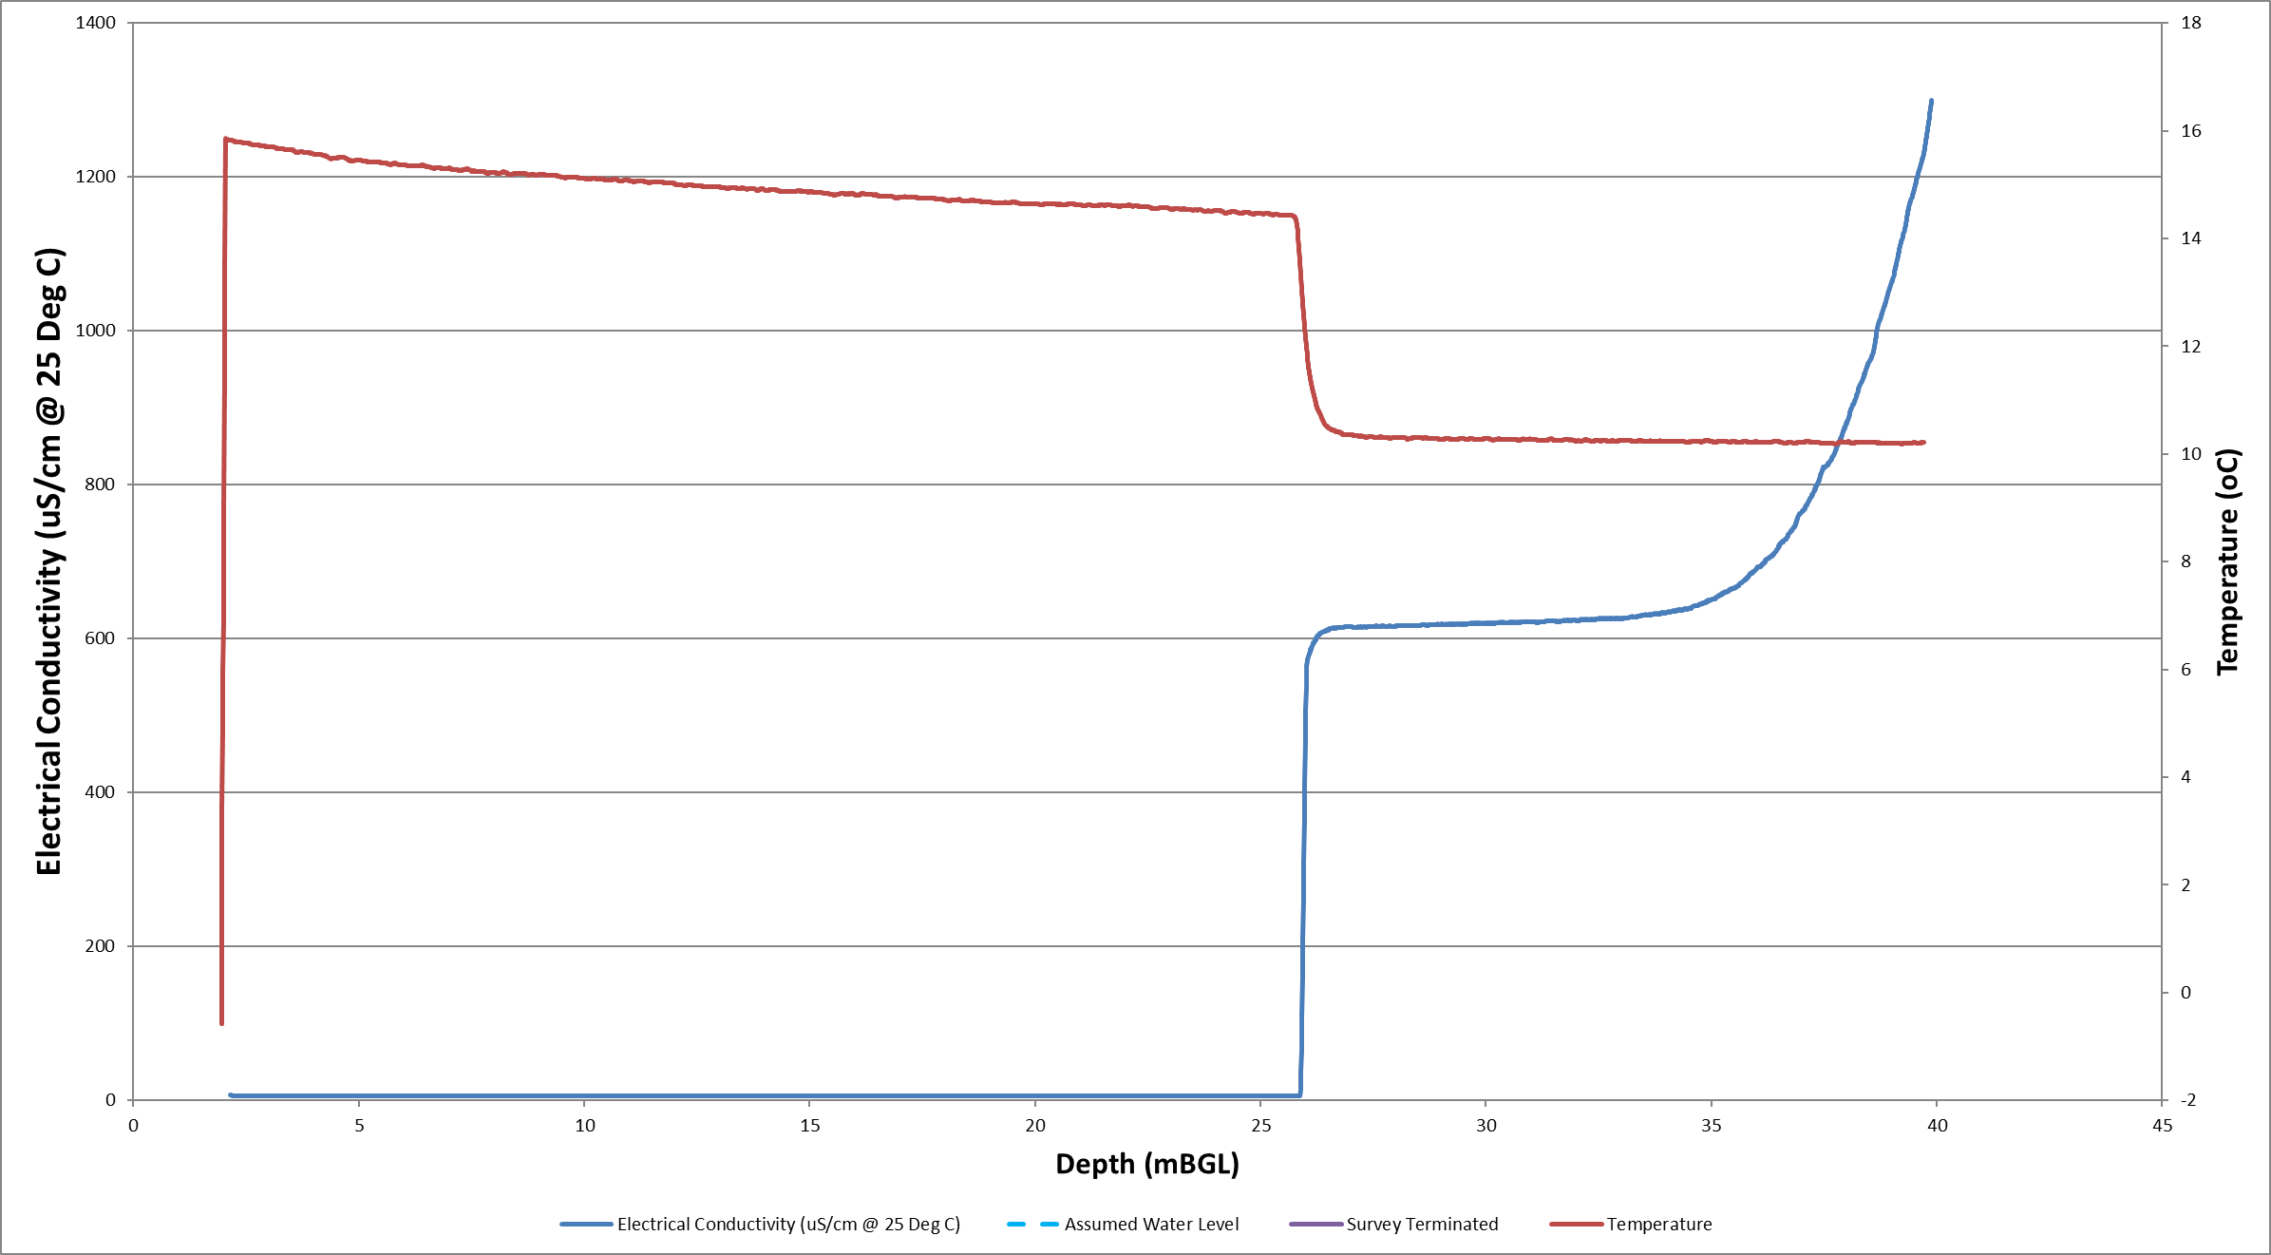
West Cannock No5 Aquifer and Seam BH - 2019
Seam Aquifer

Slide 27
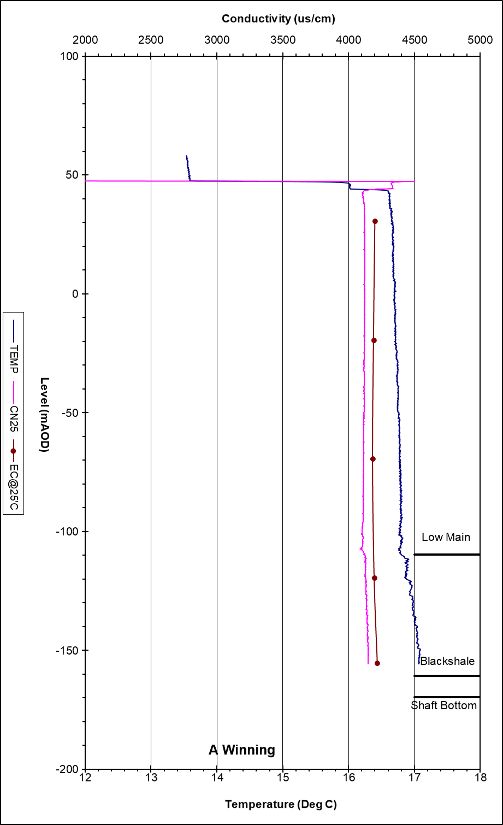
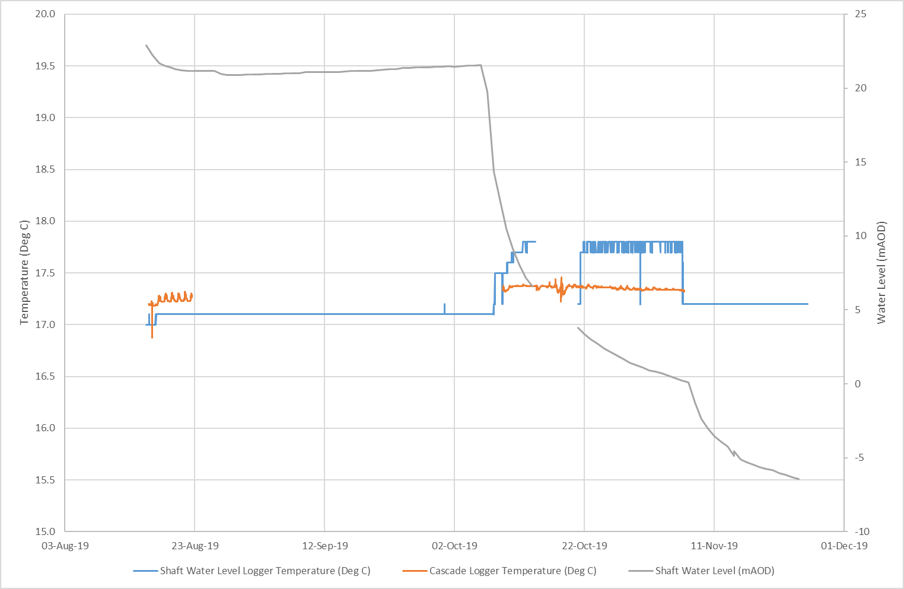
A Winning – Pumped Passive Cascade (Temperature Logger), DC shaft and Consented Discharge (Logger data)

Slide 28
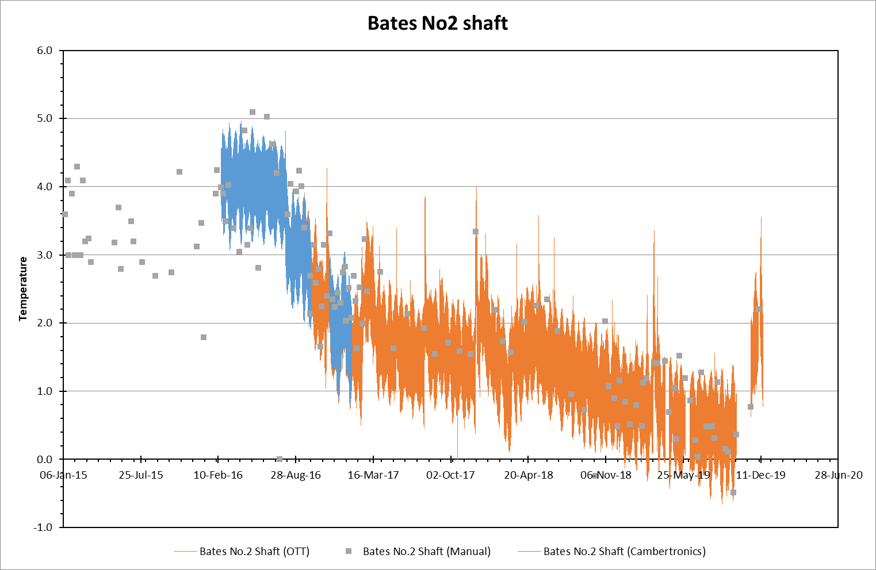
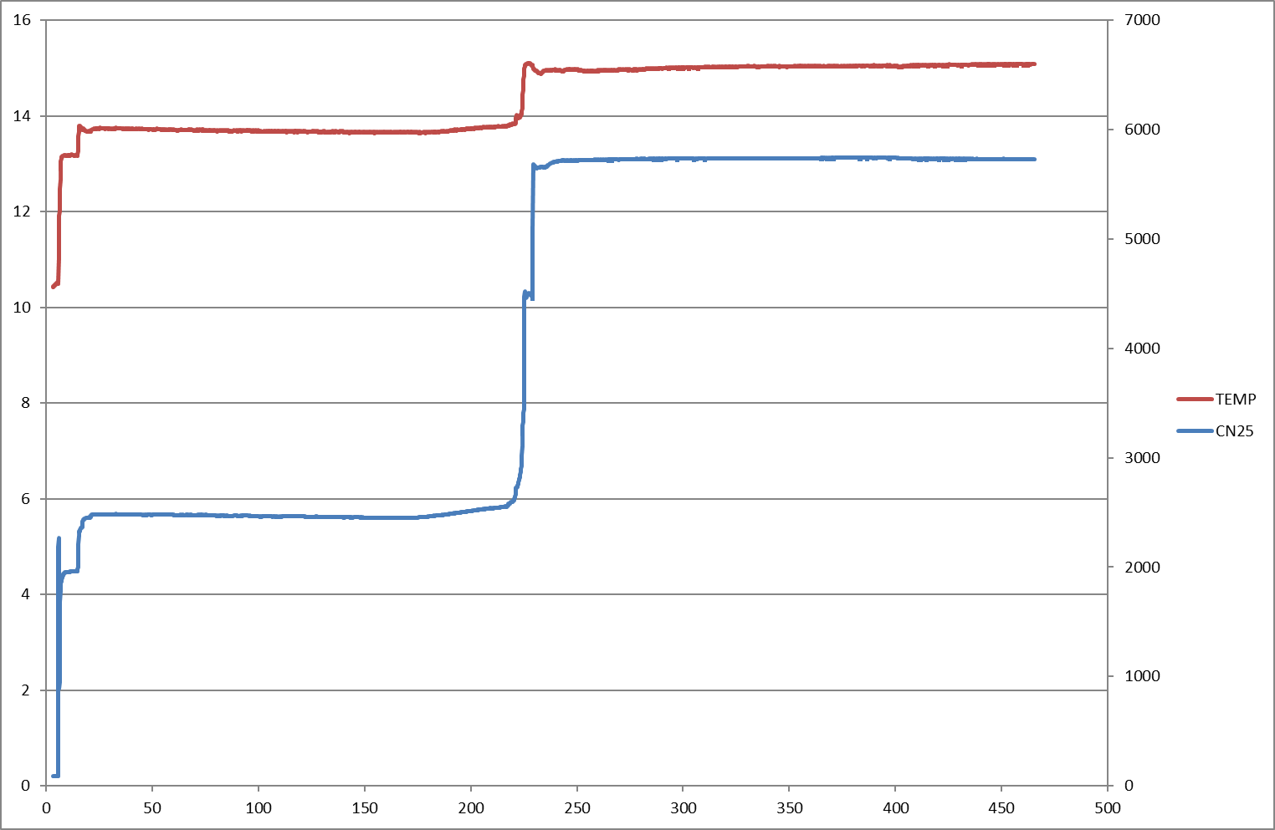
Bates Pumped - Cascade – Temperature Logger No2 shaft Log - ECT Log 2010, Water level logger No3 shaft Log - ECT Log 2010 , Water level logger

Slide 29
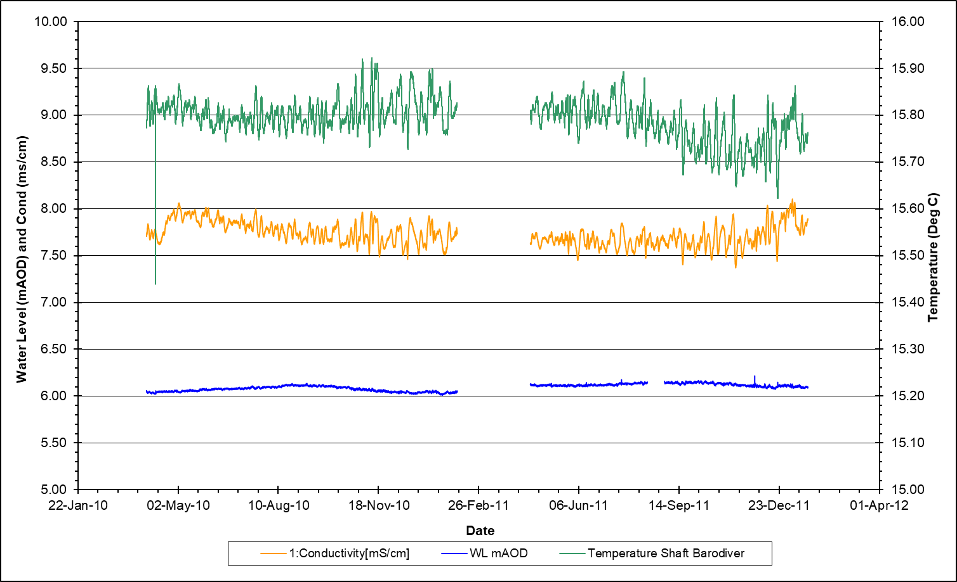
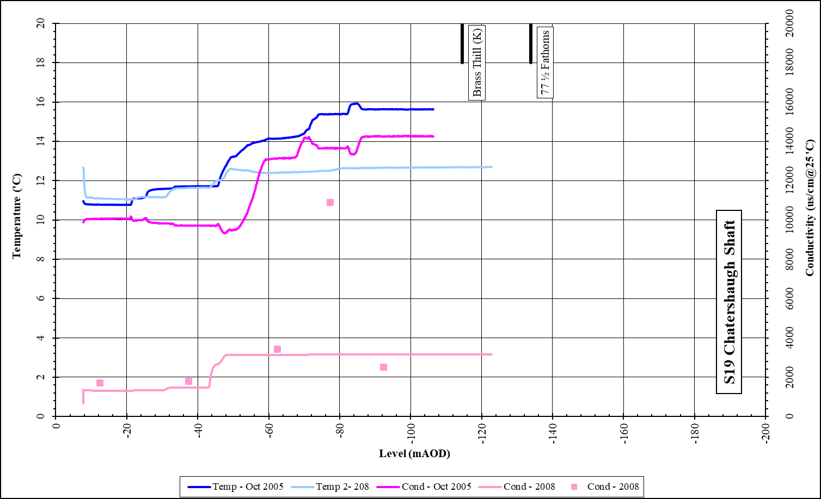
Chatershaugh

Slide 30
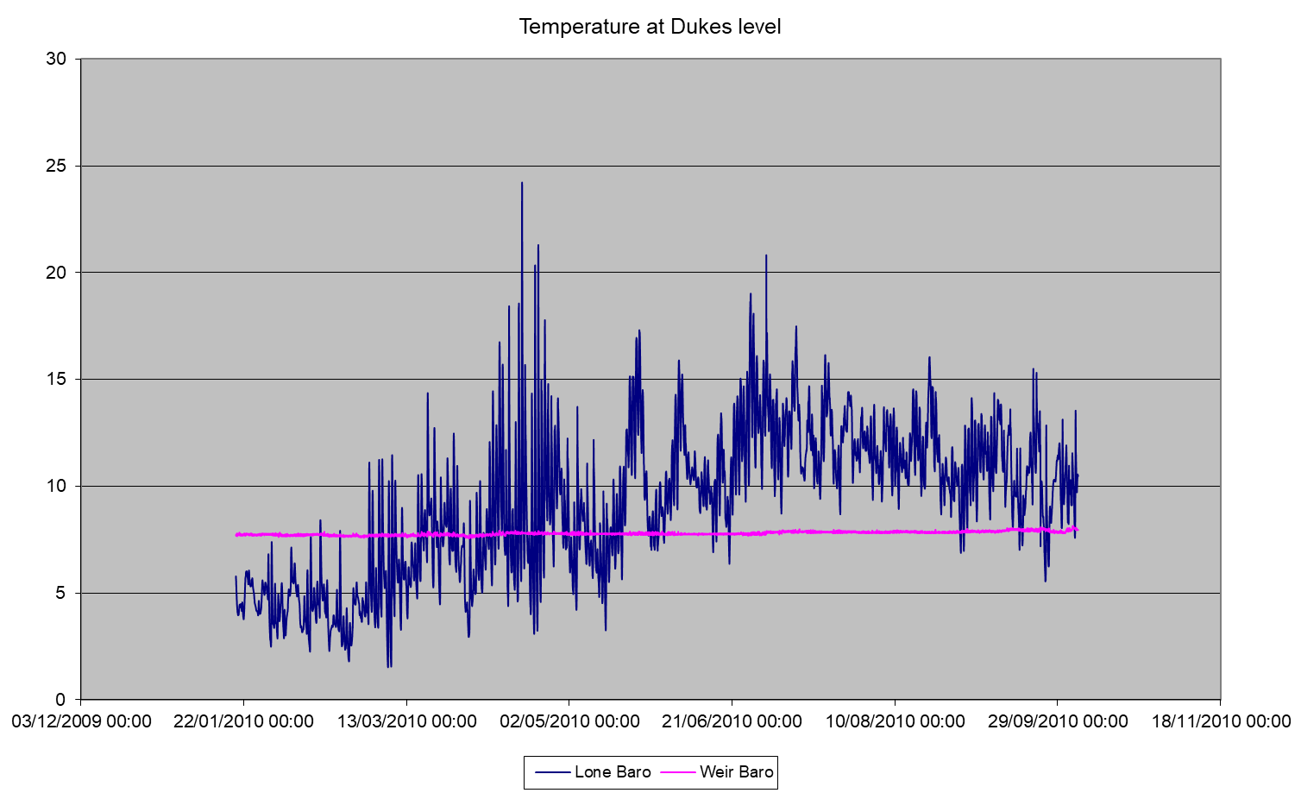
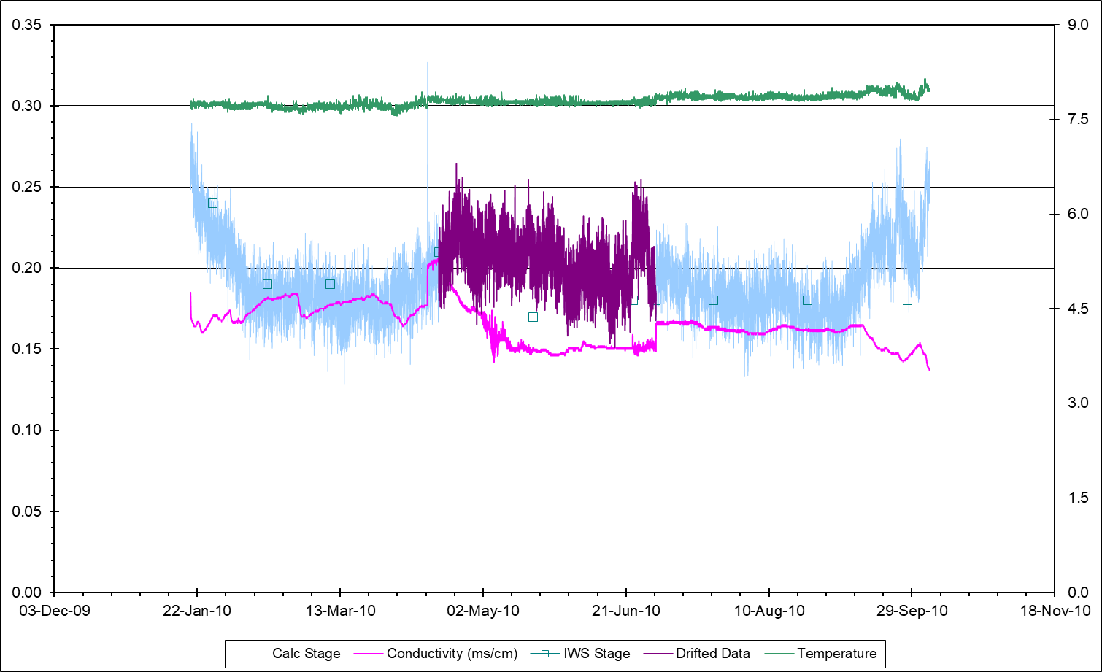
Dukes Level (discharge on surface)

Slide 31
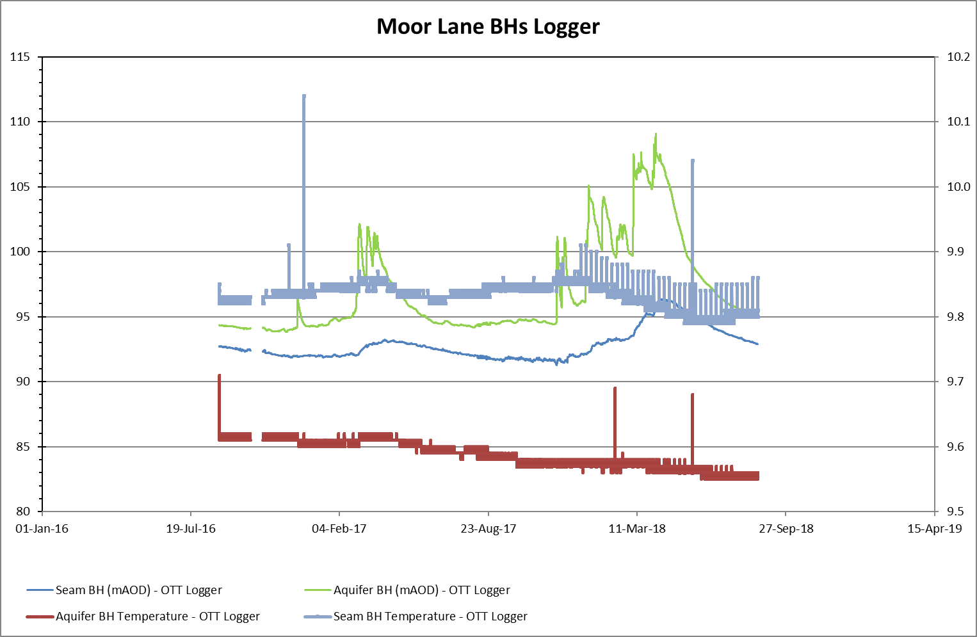
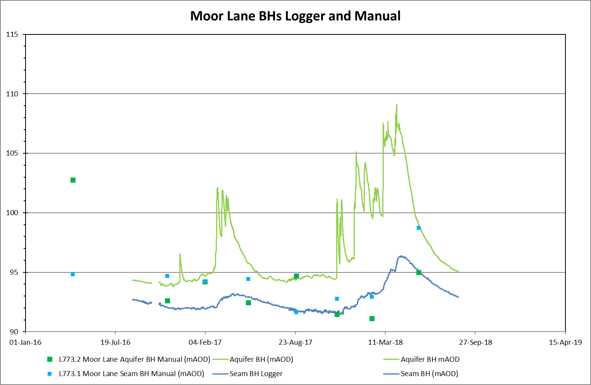
Moor Lane BH L773

Slide 32
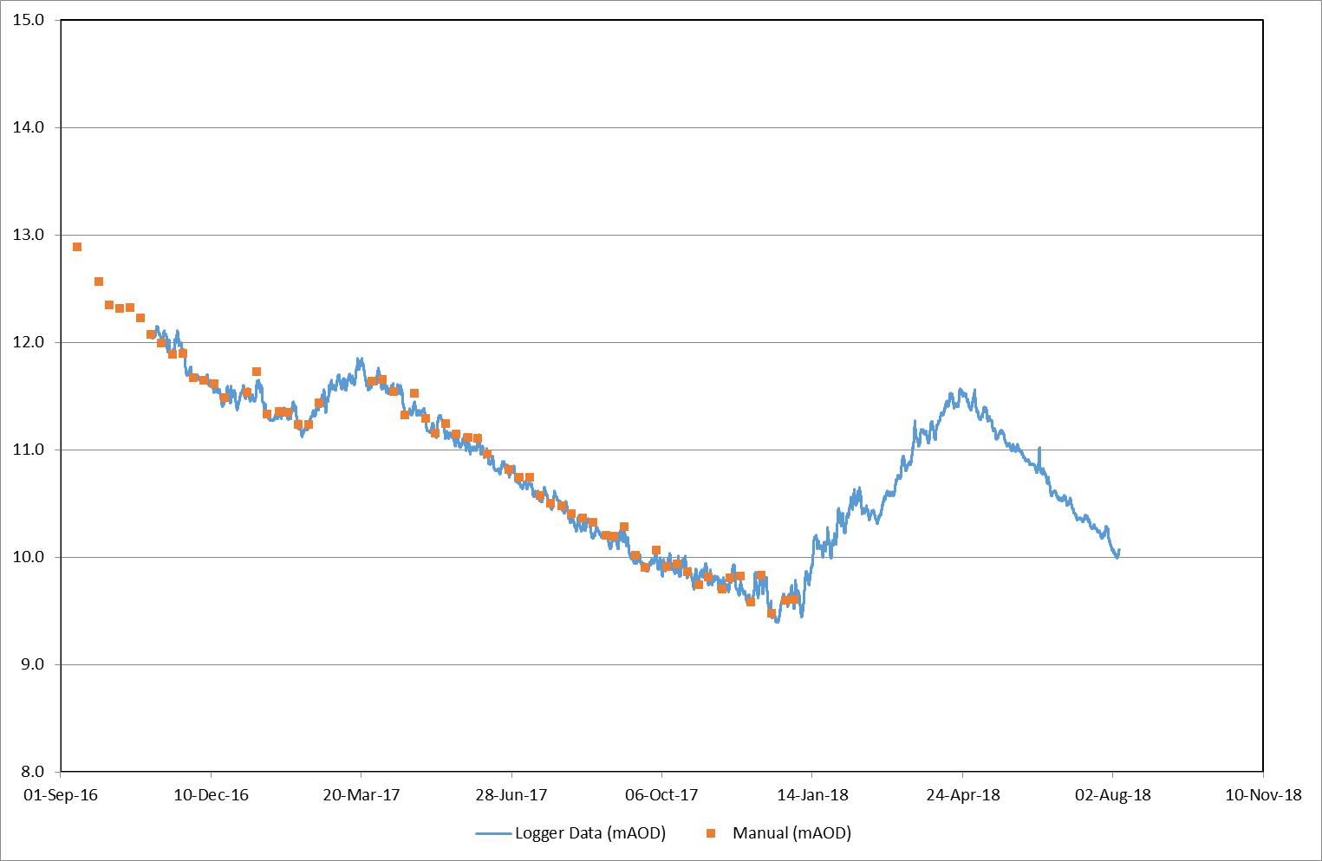
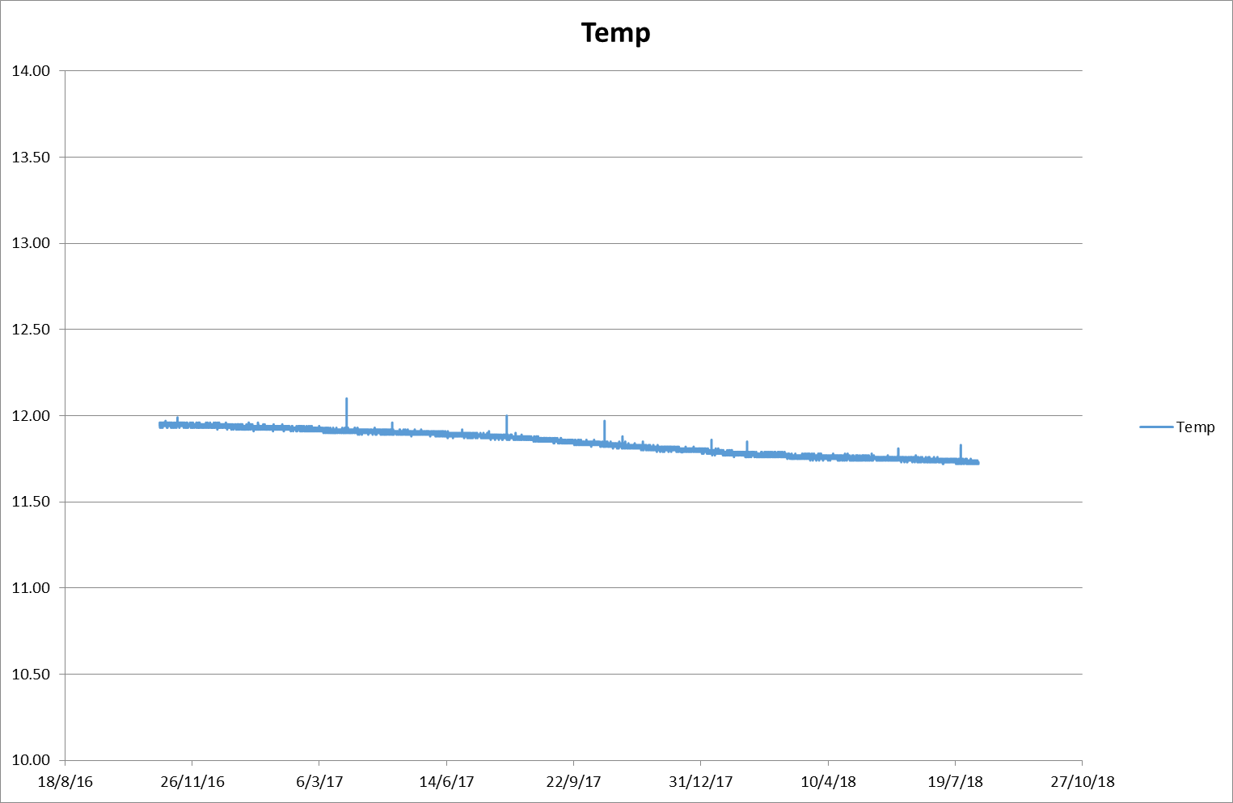
Muiredge Chemyss

Slide 33
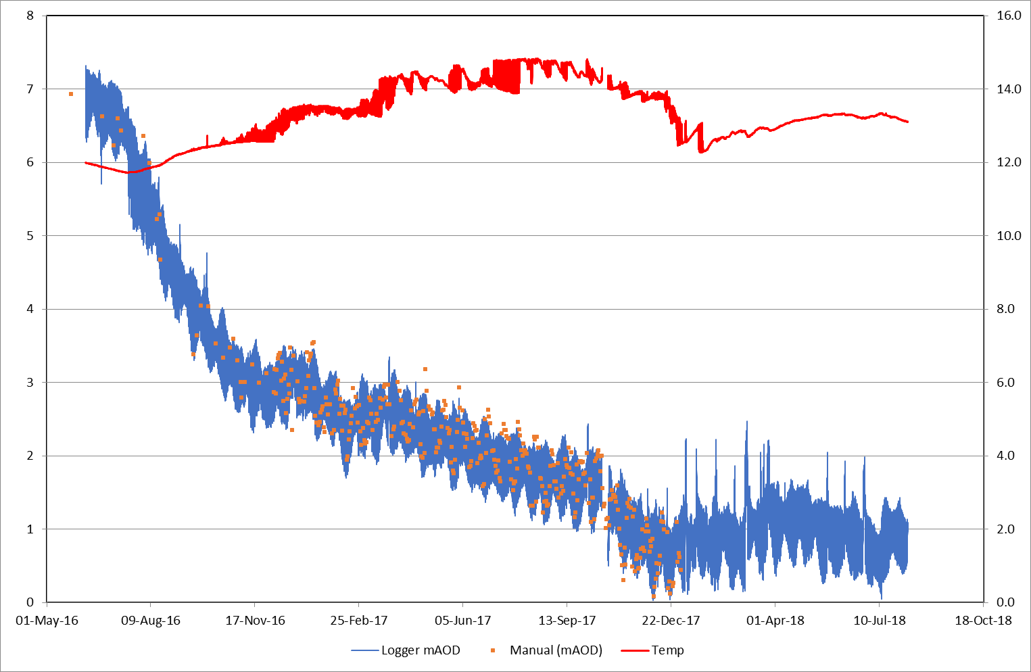
Michael logger

Slide 34
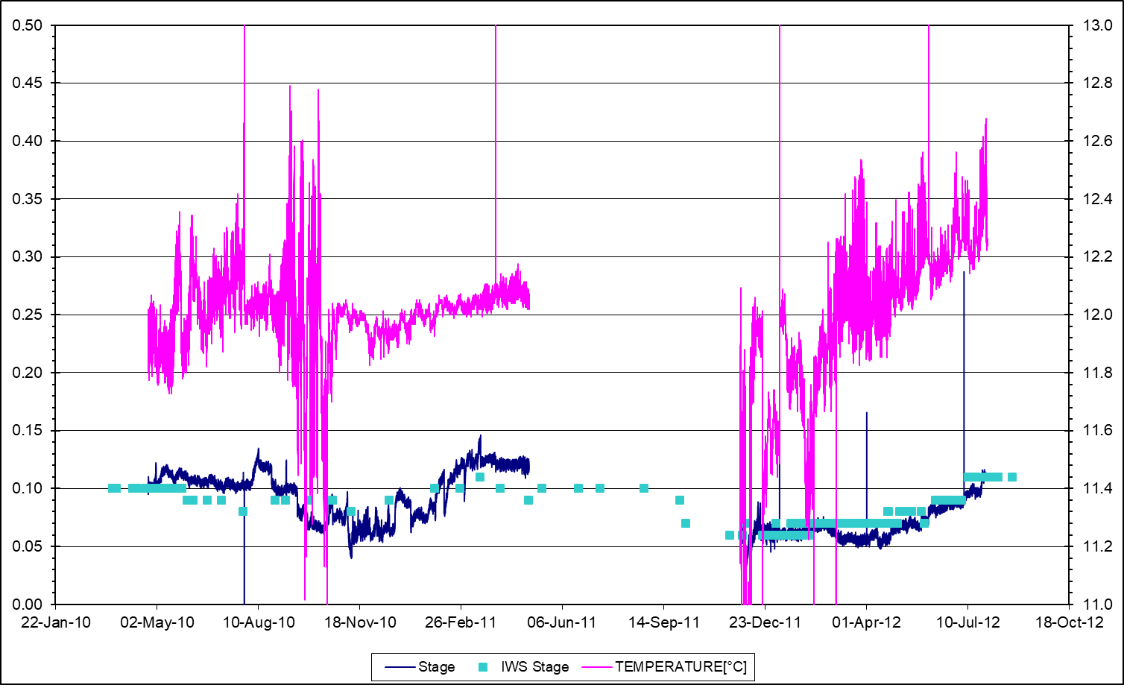
Saltersford

Slide 35
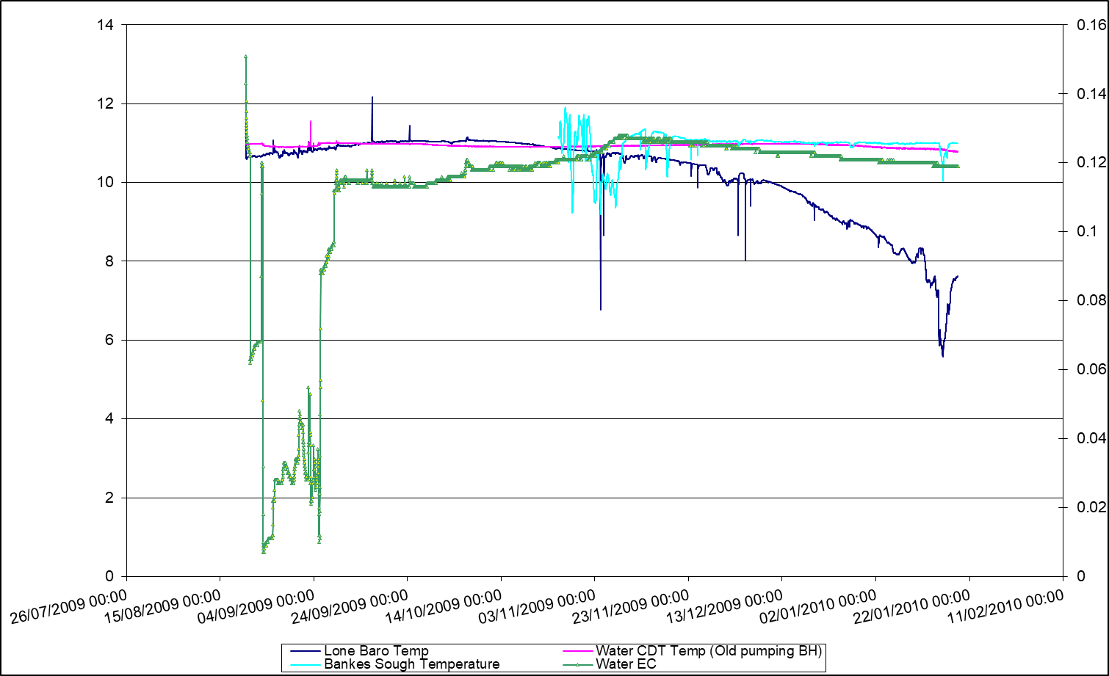
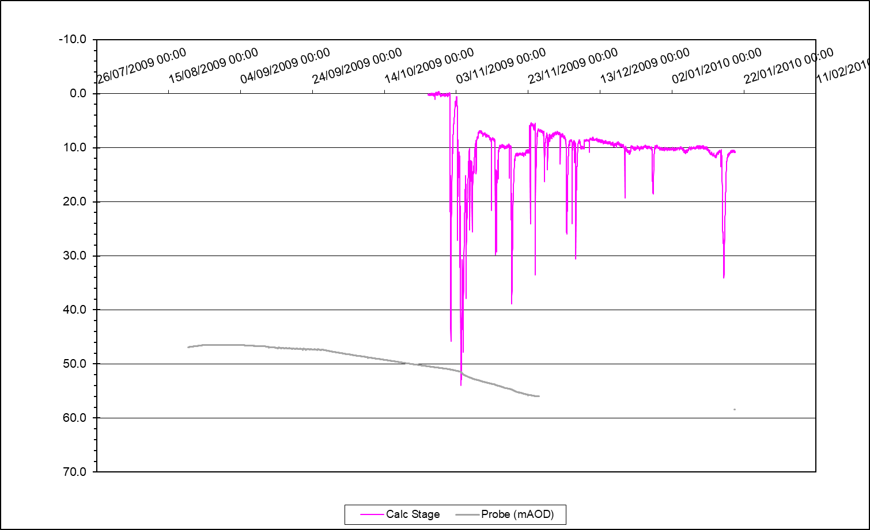
Summersales

Slide 36

Whitburn

Slide 37

Bilston Glen Shaft

Slide 38



Easthouse shaft (Great Seam Borehole)

Slide 39


Easthouse and Old Fordel (Junckies) Level

Slide 40


Easthouse - Old Fordel (Junckies) Level

Slide 41


Slide 42


Dawdon
Shafts of interest: Dawdon, Horden, Hawthorn, Easington
EC-T logs during mine flooding

Slide 43

Horden Cascade (Temperature Logger) Shaft (Logger Data)

Slide 44

Horden Shaft Log (ECT Logs)

Slide 45


Slide 46




Hawthorn
Why no step in 2003?
Notes:
Hawthorn well drilled across Main Coal G and Hutton L workings
Rouge (2000)
Bleu
Violet
Vert

Slide 47


Easington

Slide 48



Slide 49








L : -242 m at well
J : -160 m
N : -300 m at well
J : -192 m

Slide 50








Slide 51


